Slide 1
Resident Management Portal
Enrollment and Transitions
Barb DiGangi, AAOS Membership
Notes:
Introduction
Barb DiGangi, Membership Specialist at AAOS.
I work in our Marketing, Communications, and Membership Department and I am on the membership team
The membership team breaks down all communications, by channel and by career stage to make it seamless for Members to transition from one membership category to the next.
We do this through Acquisition, Onboarding, Engagement, and Retention which directly follow the Member Experience at the Academy.
AS the Membership Specialist, I ensure all new residents entering residency programs are enrolled for AAOS Membership and residents who are graduating continue their membership as they go into fellowship training and practice.
Membership is free to residents for the duration of their residency and fellowship training. Once they are members, they have access to all their benefits.
The enrollment and transition processes are done through the Resident Management Portal by the Residency Coordinators. Program Directors also have access to the portal.
The portal was developed to provide Orthopaedic Residency Directors and Coordinators the ability to upload, manage, and add residents to the roster, and enter transition information as residents near the end of their residency.
I am the primary contact for the enrollments and transitions and will now briefly give an overview of the portal itself.

Slide 2
Enrollment and Transition Timelines
March – Begin outreach to Coordinators to verify contact and program information via email.
The email will include a link to the Portal’s user guide to help get you familiar with the step-by-step process.
April 1 – The Portal is open, and Coordinators can begin enrolling their new residents for AAOS Membership and transition their PGY5 graduates.
April 1 – June 30: New Resident Enrollments can be completed.
April 1 – July 31: PGY 5 Transitions can be completed.
The portal remains open until July 31. After this date, the portal is closed to view access only.
September 1 – 30: Portal reopens for OITE Registrations.
FREE AAOS Membership begins for new residents on July 1.
Notes:
1.) New Resident enrollment should be completed by June 30 so they have access to their benefits on July 1st when membership begins.
If they are NOT enrolled by June 30, and it goes into July/August, the new residents are missing out on immediate benefits.
2.) For transitions, we know residents who are graduating and leaving the residency program so I highly encourage you to complete transitions as soon as possible.
3.) Although we’ve extended the date to July 31 to complete transitions, coordinators are busy and may forget.
4.) If we do not get that information on what the graduate is doing next, we risk losing them as members, and they won’t have benefits.
Fellowship membership is still FREE to them while they are training. Unless the transition is going practice, this would be our candidate membership and the first category the doctor pays dues.

Slide 3
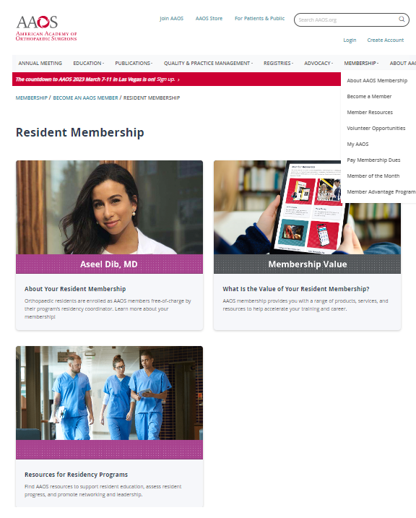
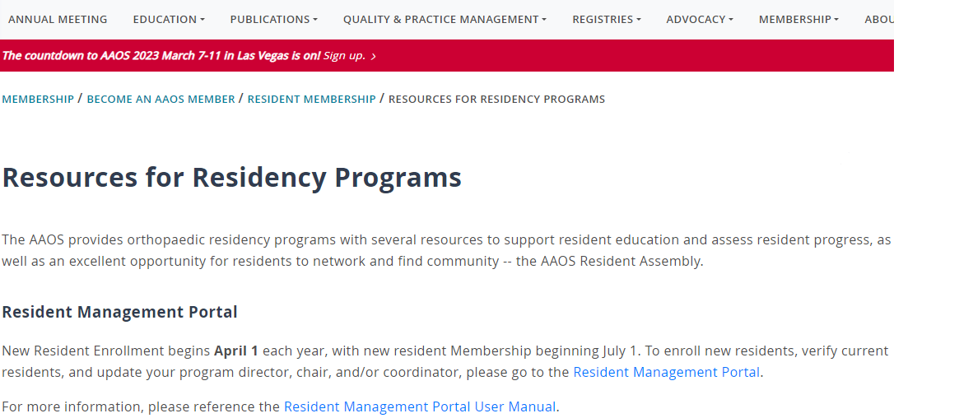
Access and Steps
The portal provides Program Directors and Coordinators the ability to:
Upload/Add residents, update information, and manage rosters
Update and complete the transition of their PGY 5 graduates
Coordinators are required to log in with their AAOS SSO (Single Sign-On) username and password to access the portal.
The portal can be accessed via the link shared in the emails and at our website at https://residentmanagement.aaos.org/ or at www.aaos.org
Resources for Residency Programs
URL link: https://www.aaos.org/membership/become-an-aaos-member/resident-membership/
Notes:
Once emails are deployed in April, you can begin accessing the Portal. There are two ways to access it. That is through the link I send via email, and you can access it at our website at www.aaos.org.
Program directors also can access the portal.
Single sign-on is required to log into the portal, that is your AAOS Username and Password. If you are new to the AAOS website and don’t have a record, you can create one at our website www.aaos.org. You can then contact me and I will relate your record to your RP Program record.
Once records are created in the AAOS system, it is a permanent record. You’ll want to save those login credentials for your record-keeping.
If you need any help with creating records or updating your account profile, please contact our service center.

Slide 4
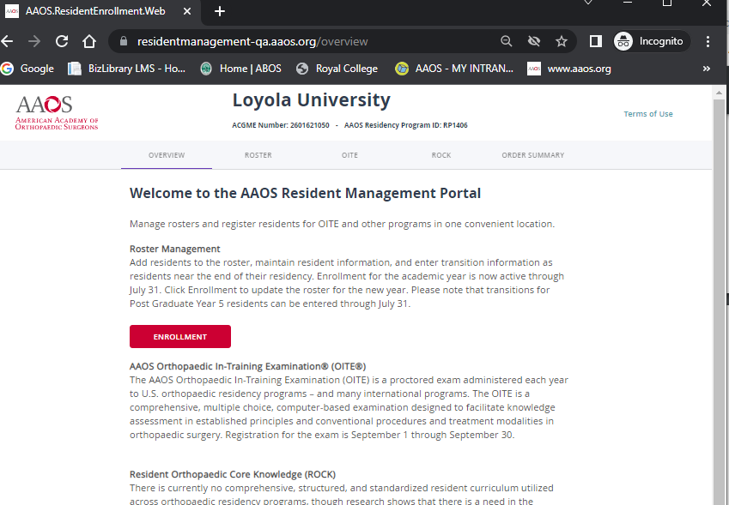
Resident Management Portal – Steps
Once you are logged in, you will reach the Portal's Overview tab.
Residency Program Name, *ACGME Number, and Residency Program ID
*The ACGME Number is given by the Accreditation Council for Graduate Medical Education, and the Residency Program ID (RP + 4-digit number) is given by AAOS. Coordinator records are related to the RP records.
Click ENROLLMENT button or ROSTER tab to manage your roster
Notes:
Here’s an overview of what you will see once you are logged in.
You should see your residency program name, the ACGME number, and your AAOS RP Program Record ID.
The ACGME number is given by the Accreditation Council for Graduate Medical Education and NOT by AAOS.
The RP number is how we identify the residency program record in the AAOS system. It is RP + a four-digit number. For Example here, Loyola University’s AAOS ID is RP1406, and your own AAOS record as the coordinator is tied to the RP record, and so begins the relationship.
When the residents are added to the system, they will also be tied to the RP record.
You will also see the Overview Tab, Roster Tab, OITE Tab, ROCK Tab, and Order Summary.
To begin enrolling your residents just click on the button.

Slide 5
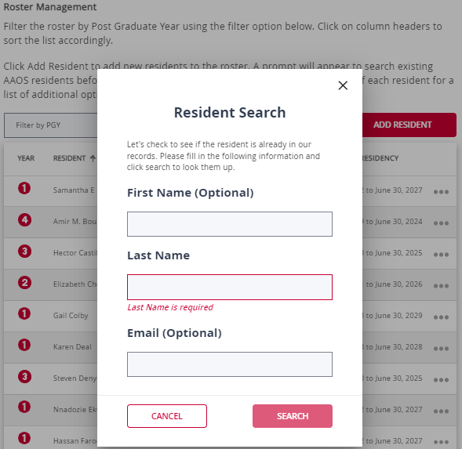
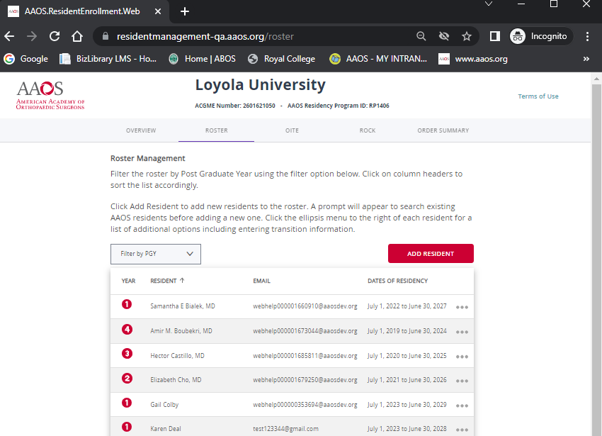
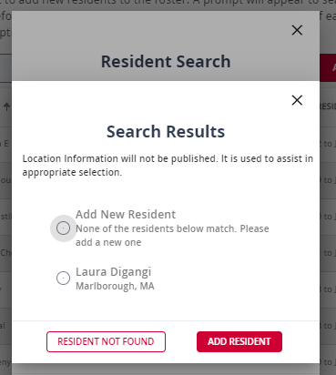
Search and Adding Residents
You will have the ability to enter your Resident's First Name (Optional), Last Name, and Email (Optional). Once you have entered your Resident's details, you will click the red SEARCH button located at the bottom right of the Resident Search window
In Search Results, the resident’s name will either appear or you will need to ADD NEW RESIDENT
To search for a resident to add to your roster, you will click on the ADD RESIDENT tab located at the top right of the roster table. Once you click on this button, a Resident Search window will open
Notes:
Once you click the enrollment button, you see your CURRENT roster of residents, with their begin and end dates, their PGY levels, and email addresses.
You’ll see the button to ADD RESIDENT, and this is where you will begin to enroll your new residents.
Once you click the button, just follow the prompts and enter the required information.
You can type the last name only, but it also gives you the option to enter a FIRST NAME and an email address. I recommend, only searching using the LAST NAME.
Once you type in the information, a name will pop up if they are in the system, and if not you can them.

Slide 6
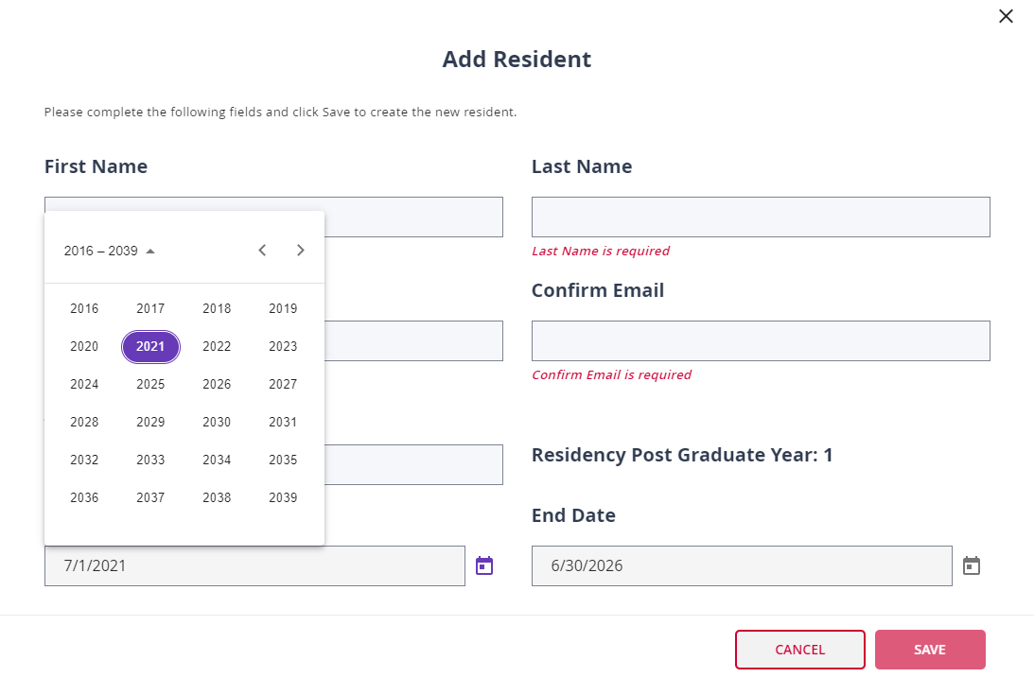
Completing Resident Information
Enter all required information
Start date will pre-populate with 7/1 of the current year, and the end date with 6/30 five years out
Click on calendar icon to select the year and proceed to select the start date of July 1 and end date of June 30 five years out. Click SAVE when all fields are filled in
The start date of 7/1 and the end date of 6/30 are non-editable, but the year can be changed by the calendar icon
No other start and end dates outside of July 1 and June 30 are available for selection. For example, a resident may be off track and start on September 1. The 7/1 date can’t be changed.
Notes:
This is just completing the rest of the information so just follow the required fields.
I want to note that the begin and end dates are pre-populated and will start with July 1 and end date June 30 five years out.
There limitations to what you can edit in the portal so, you would have to contact me for changes in the PGY year, or a begin date that is off track from the normal residency cycle.
For example, if a resident is starting on September 1, you will not be able to change the start date to September 1, etc.
The PGY field is also non-editable, and will only change by changing the years in the Calendar Icon.

Slide 7
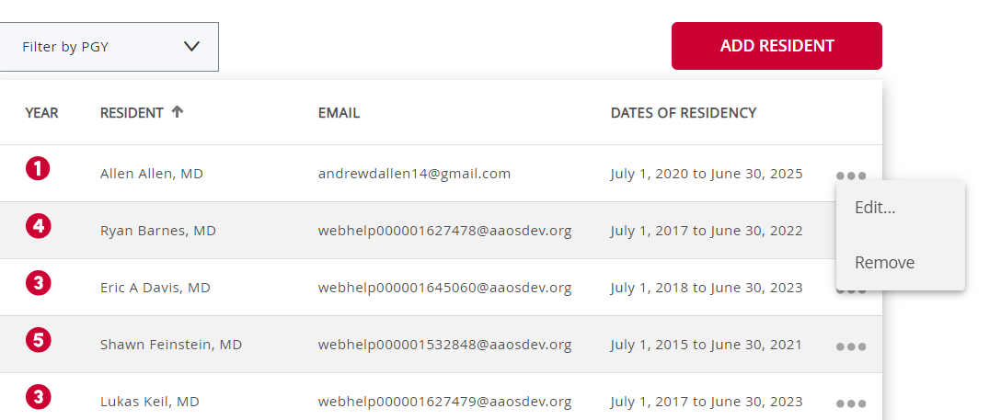
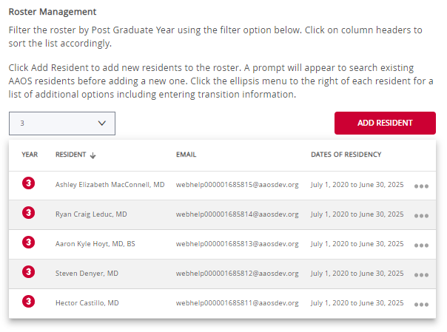
Roster Management | Sort By PGY Year or Name, and Edits
Sort roster by PGY level using the "Filter by PGY" dropdown feature
Sort residents alphabetically by last name, hovering cursor over the arrow that appears in a column titled RESIDENT, and click up or down to sort accordingly
Click on the ellipsis menu to the right to Edit but only the year of the resident’s start and end date can be changed to change the PGY level.
Remove option should only be used for residents leaving an orthopaedic program. *DO NOT remove residents who need to be transitioned
PGY level is non-editable and can only be changed by using the calendar icon feature
*Removing a graduating resident versus transitioning them, the resident will lose all AAOS Membership, benefits and will not transition to the correct Member category post residency graduation
Notes:
Once you have entered all your new residents, you can sort residents by PGY Year alphabetically by LAST NAME.
You can click on the ellipsis, to the right of a resident’s name and EDIT.
For the REMOVE option, you will only use this to remove a resident from the roster if they have left the program and the ORTHOPAEDIC specialty altogether. This means we will no longer track them for membership at AAOS.
If by chance you remove a resident accidentally, please contact me and I will add them back to the roster.

Slide 8
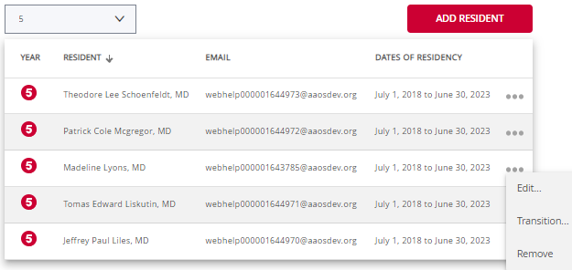
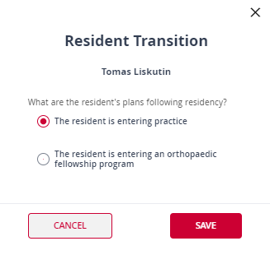
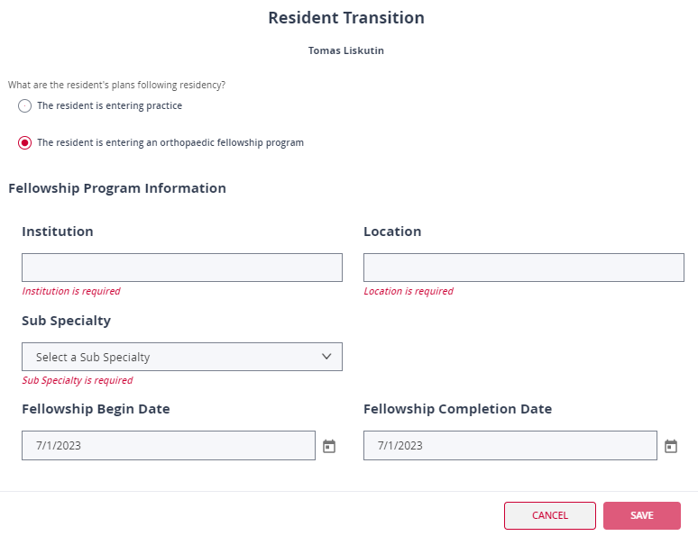
Roster Management | Entering Transitions for PGY5
Sort roster by PGY level 5 using the "Filter by PGY" dropdown feature
Click on ellipsis menu and select Transition
A window opens to choose if resident is entering practice or fellowship; selecting fellowship opens another window to enter fellowship information
Remove option should only be used for residents leaving an orthopaedic program. *DO NOT remove residents who need to be transitioned
*Removing a graduating resident versus transitioning them, the resident will lose all AAOS Membership, benefits and will not transition to the correct Member category post residency graduation
Notes:
Continuing with the Roster Management, here is a quick overview of transitioning your PGY 5 residents.
It is pretty much the same thing as adding new residents, you’ll sort the roster for your PGY 5s and complete the required fields to transition your residents.
Click on the right ellipsis, and now you’ll the transition option. You’ll want to click on Transition and complete the required fields.
If they are entering practice, select that and it will update the record in the AAOS system. If entering a fellowship, it will ask for those details, and update in the AAOS system.
This transition is very important because this is how we retain our members, and get them to the next category of membership.
As mentioned before, do not remove a resident if they are going into a fellowship or in practice. This will end their membership immediately. They must be transitioned to maintain membership.

Slide 9
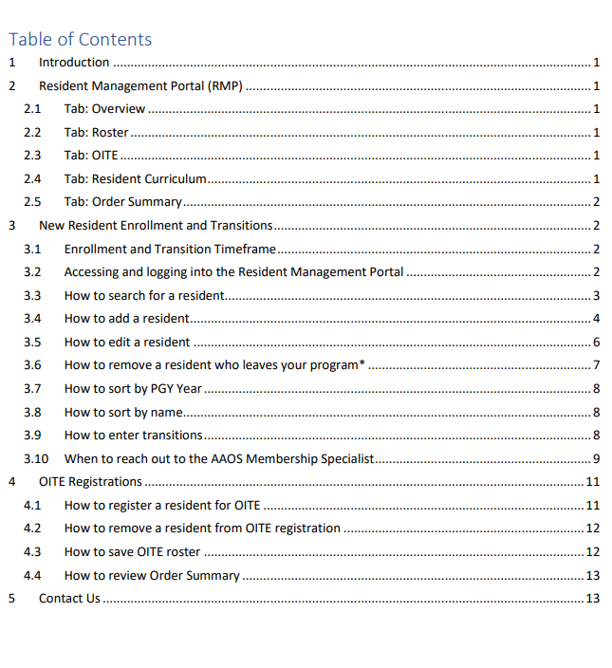
Resident Management User Guide
Frequently Asked Questions
Valuable resource with step-by-step instructions
Provides all the answers for enrollment and/or transition questions
Guide can be accessed by visiting link below
I am a new program coordinator. How do I get access to the portal? Contact the membership specialist at join@aaos.org. An AAOS record is created by the membership specialist, and instructions to set up AAOS log in credentials will be sent via email.
I get an error message that I cannot save resident. What should I do? Click the cancel button, go back to the Resident Search window. This time, do not enter an email address. Search by last name only.
How do I change my resident’s PGY level? The PGY level is a non-editable function in the portal. It will change automatically by using the calendar icon; entering the year for the begin date of 7/1 and end date of 6/30. For residents off track entering a program with another start date, for example, 9/1 or end date of 12/31, contact the membership specialist at join@aaos.org.
Do I remove my PGY 5 residents after transitioning them? No. Removing a transitioned resident, risks losing that resident’s AAOS Membership. Only residents leaving an orthopaedic program for a different specialty or other reason should be removed.
How do I change my resident’s profile information? Contact the AAOS Service Center at customerservice@aaos.org.
Portal and User Guide: https://www.aaos.org/membership/become-an-aaos-member/resident-membership/resources-for-residency-programs/
Notes:
The User Guide can be accessed at the website or though the emails I send for the enrollment and transition processes.
The top 3 FAQ’s are:
1.) New coordinators gaining access to the portal; can reach out to me and I can help get you set up with an account, if you have not created your own. Then relate your account record to the Residency Program’s record.
2.) If you get an error message that a resident can’t be saved in the system, click the cancel button and go back to the search window, and make sure to only add the last name. This is the system telling us, that the resident already exists, and may have another email address on file that’s not matching up.
3.) How to change PGY, just contact me because it is not an editable field.
You can find these answers and more in the User Guide.

Slide 10
URL Links and Support
Direct Link to Resident Management Portal (RMP) - SSO Login Required: https://residentmanagement.aaos.org/
Membership Webpage Link to Portal and User Guide: https://www.aaos.org/membership/become-an-aaos-member/resident-membership/resources-for-residency-programs/
Questions/support for resident enrollment, program, program director/residency coordinator updates contact the Membership Specialist at join@aaos.org
For general inquiries about membership or a product or service and/or support contact the AAOS Service Center at customerservice@aaos.org or 800-626-6726

Slide 11
Thank you!

