Slide 1
ROCK Update
Courtney Dunker, ROCK Product Owner
February 13, 2024

Slide 2
ROCK Overview

Slide 3
ROCK | Response to Need
Comprehensive Content:
Remediate to full text; create a standardized reading curriculum complete with articles and book chapters that ensures a well-rounded education. “Emphasize reading journals and understanding why, not just memorizing facts.”
Resident Focused:
Keeping residents of all levels in mind, start with the basics and build from there; milestones to meet as you progress; affordable; efficient.
Consistency in Core Clinical Knowledge: “Consider that residents are taught by attendings trained in various settings and with various skill sets, would be nice to see consistency in core clinical knowledge that can be applied across the board.”
OITE/Board Study:
“AAOS has the resources and ability to create a great learning resource and curriculum for programs that are not strong academically.”
Downloadable Content/Seamless Integration with Devices:
“Allow the program to transition seamlessly from phone to desktop to tablet and make it available online and offline (not a lot of service in ORs or while traveling).”
Centralized Education:
Residents use Orthobullets because the information is all in one place; not necessarily because the content is in depth or reputable. (May Strategy Group)
*Content is always accessible to residents regardless of program subscription status

Slide 4
ROCK | Intention
Cornerstone
Built as a resident education foundation
Milestone
to track and assess learning progress
Touchstone
while enabling communication between Program Directors and Residents

Slide 5
ROCK Product Rollout and Usage

Slide 6
ROCK | Product Rollout
March 2022-June 2023
2023-2024 AY
2024-2025 AY
Launch of Free Trial
ROCK/ResStudy Bundle
Paid Launch
Product launched with Basic Science and Spine content, basic platform functionality
All US-based ACGME accredited programs enrolled for free trial*
Trial ends on June 30, 2023
All content on platform
Critical features implemented
ROCK offered free with ResStudy subscription; offer ends June 30, 2024
ROCK available to US-based and international programs for purchase as a standalone product
ROCK available for purchase as standalone product
ROCK available for purchase as bundle with ResStudy and OITE
ROCK available for purchase by international programs
*Content is always accessible to residents regardless of program subscription status

Slide 8
ROCK | US Residency Program Market
170/208 (81%) US programs with ROCK access
166/170 (97%) of US programs with access to ROCK are using the platform in Q4
170 of the 208 domestic programs have access to ROCK by virtue of their ResStudy subscription
Of those 170 programs with access, 166 programs (97%) used the platform in Q4. Usage is defined by logins by program directors/admin & residents, resident assessment usage, or program engagement with the study schedule or assignments features

Slide 9
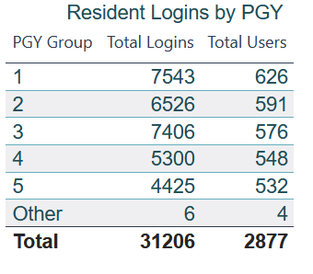
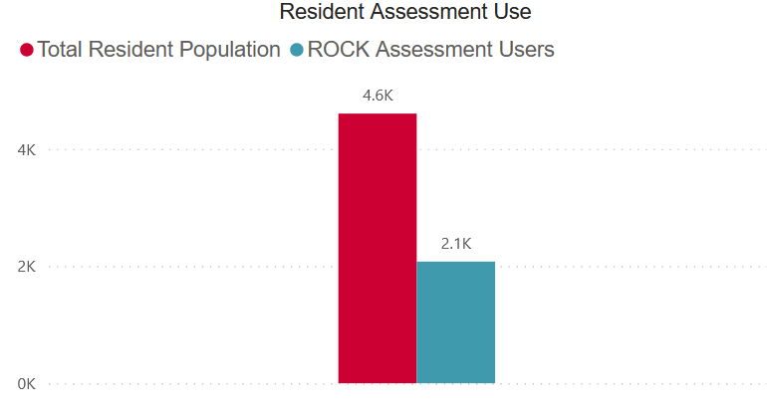
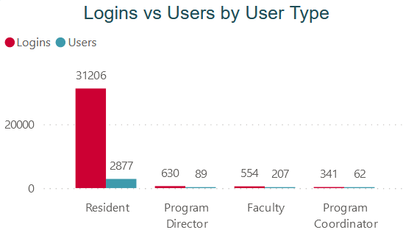
ROCK | US Resident Market
63% (2877) of the total domestic resident population logged in to the ROCK platform from July 1-December 31. 46% (2.1k) of the total domestic resident population utilized the assessment features in the platform in that same time period
2100/4548 resident assessment users
(46% of total US resident population)

Slide 10
ROCK Content

Slide 11
ROCK | By the Numbers
CONTENT
CURATION
11
Subspecialties
545
1000+
90
22
Chapters
Full-text Journal Articles
Section Editors
Subspecialty Editors
ROCK.AAOS.ORG
700+
Authors
3400+
1000+
Test Questions
Full-Text Book Chapters
800+
Videos

Slide 12
ROCK Study Schedule

Slide 13
ROCK | Study Schedule Overview
AAOS Default Schedule
Customizing
Delete or add chapters to the default weekly assignments
Select entirely new selection of chapters for each default weekly assignment
Blocking
Group pieces of related content together in blocks
Move blocks along the schedule to place in desired dates
Resequencing
Move weekly assignments along to calendar to desired dates
Move blocks of content along calendar to desired dates
Cloning
Clone modified schedule to assign out to multiple residents
Clone default schedule before modifying to create multiple schedules
AAOS creates a two-year default schedule; a new two-year cycle will be published every year
The default schedule is completely customizable to align to your program’s education schedule

Slide 14
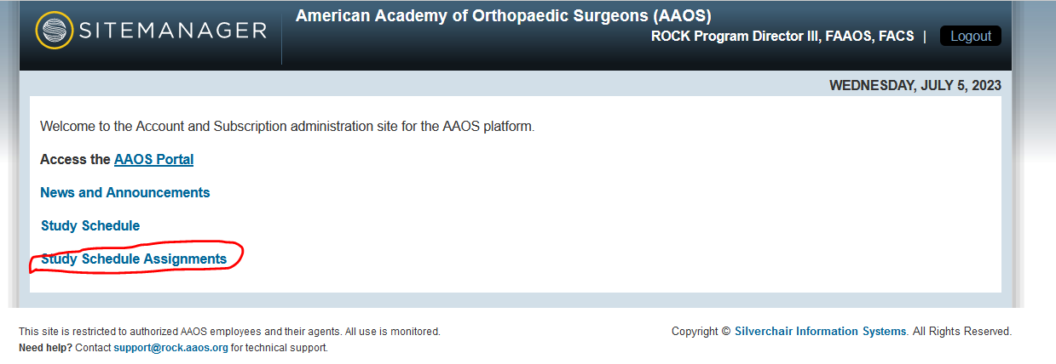
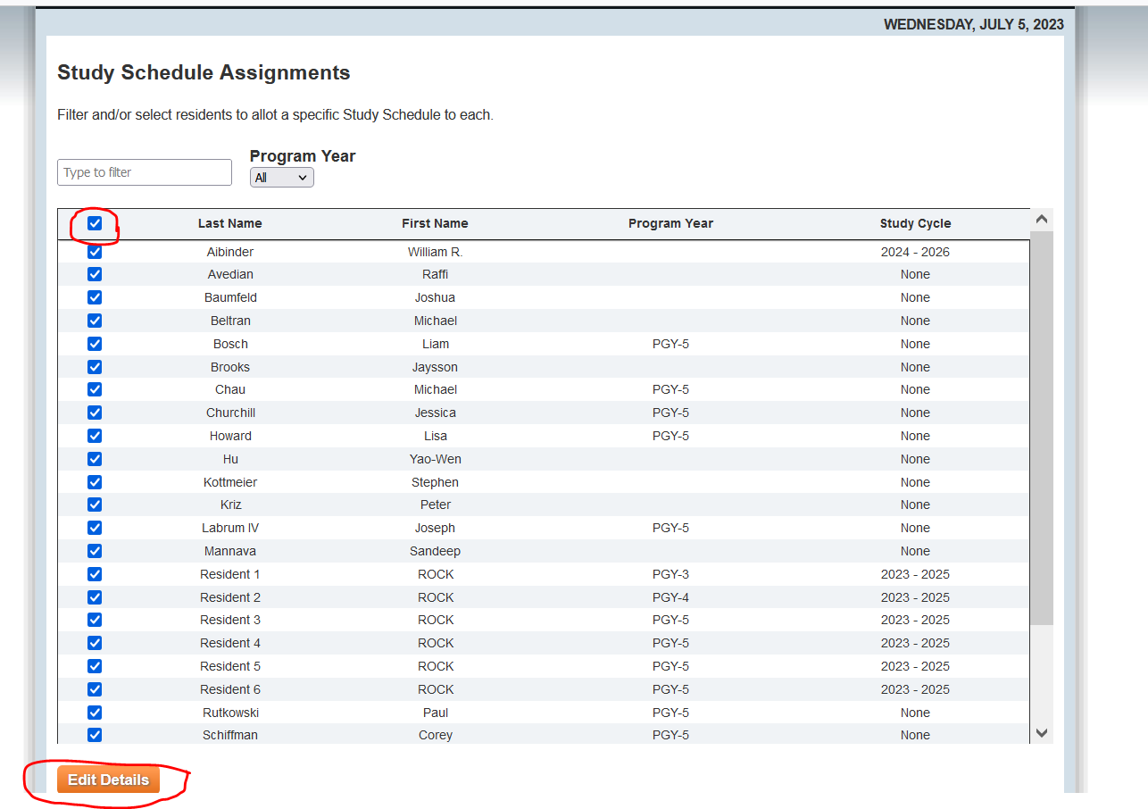
ROCK | Assigning Study Schedule
*ROCK Study Schedules must be assigned to residents for them to see their weekly assignments in their dashboard

Slide 15
ROCK Performance Analytics

Slide 16
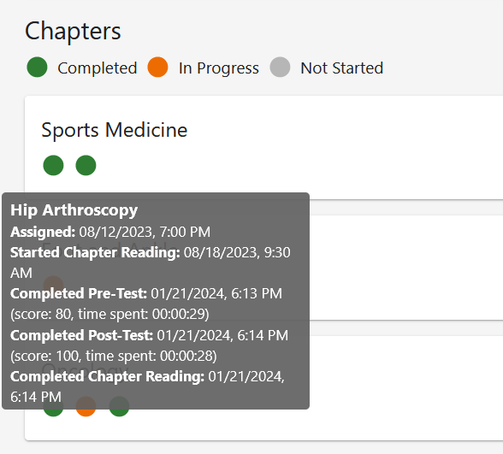
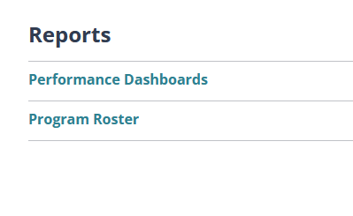
ROCK | Performance Dashboard
Subscribing institutions have access to their program-level analytics and can track resident progress on assignments, performance on pre/post-tests, and see how their program performance compares to the performance of other programs in the platform, as well as how individual resident performance compares to their peers in the platform
AAOS Default Schedule
Performance reports can be accessed with the Peformance Dashboard link found in the user’s “My Dashboard”

Slide 17
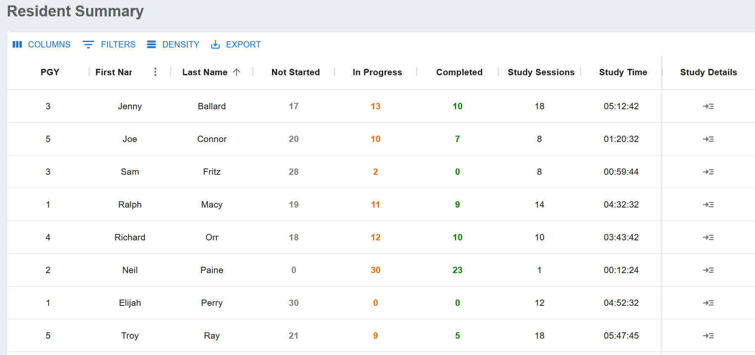
ROCK | Updated Analytics
Implementation of updated analytics is underway, with changes expected in the platform by end of March. New additions to the performance include:
Time tracking will be a prominent metric in the updated dashboards, as well as assignment completion, so program directors can stay informed about resident progress and performance

Slide 18
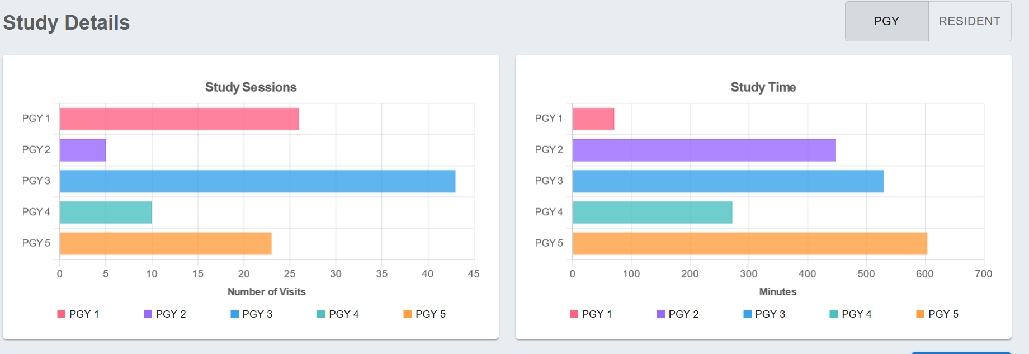
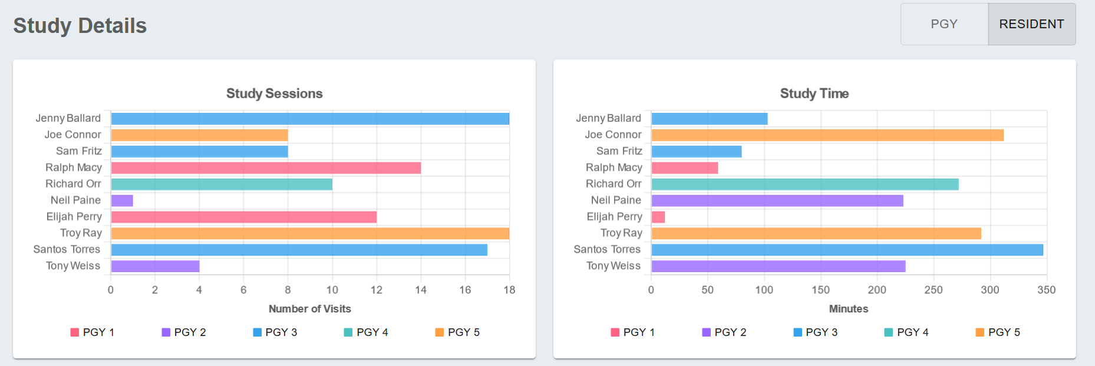
ROCK | Updated Analytics

Slide 19
ROCK New Features

Slide 20
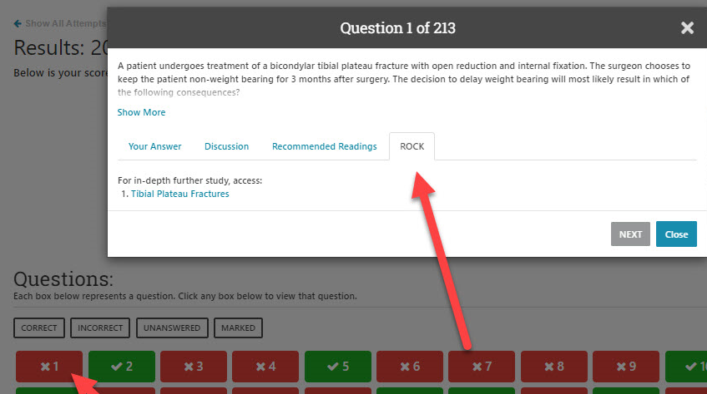
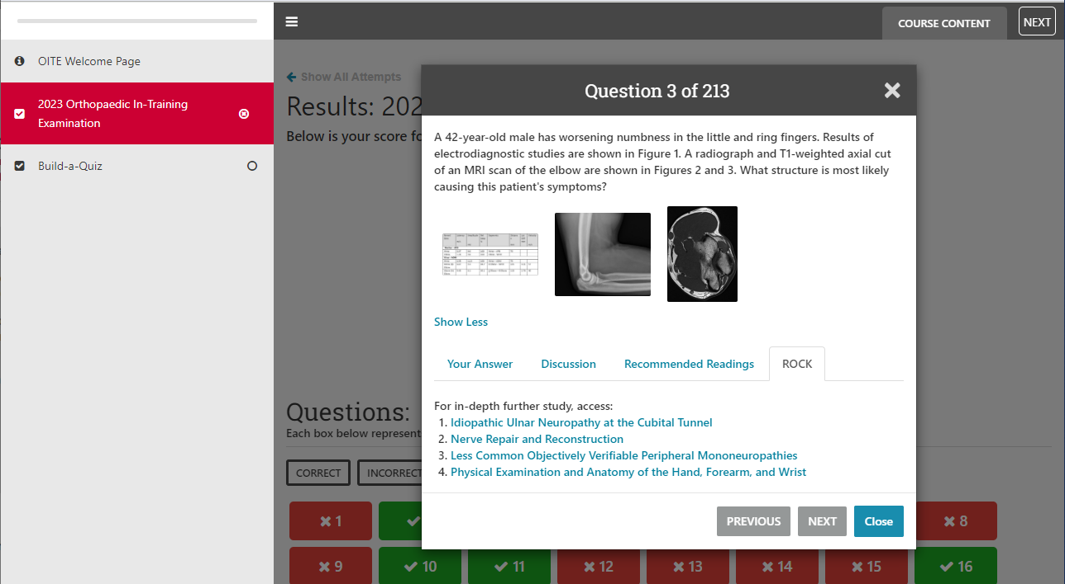
ROCK-OITE links

Slide 21
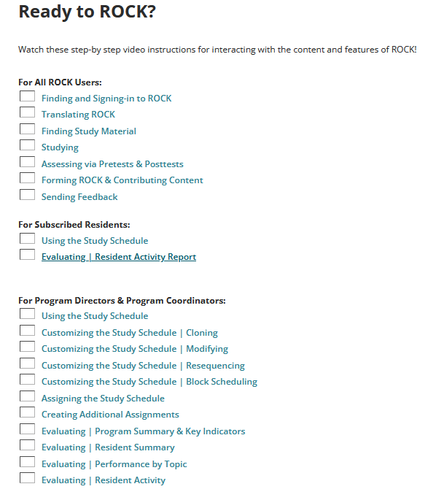
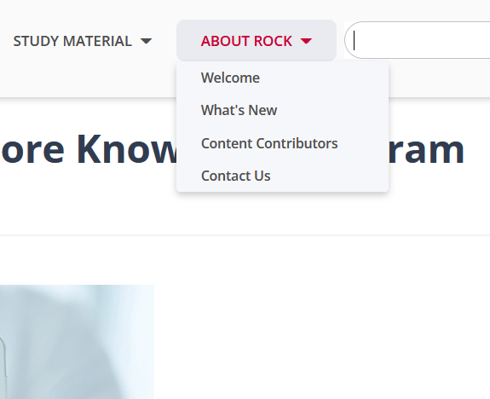
ROCK | Video User Guide

Slide 22
ROCK AY 2024-2025

Slide 23
Resident Education Bundle
Visit the ROCK booth in the Learning and Practice Store, South Esplanade Lobby, to learn more about the bundle pricing for your program
Programs who commit to purchase the bundle at Annual Meeting will receive a 10% discount
After meeting, call the AAOS Customer Service team to inquire about getting your program set up with the bundle of products

