Slide 1


2023 Recap and 2024 Preview

Slide 2


ABOS Part I/OITE Linking Study
The American Board of Orthopaedic Surgery (ABOS) and the American Academy of Orthopaedic Surgeons (AAOS) collaborated on the development of a collection of examination items that were included on both the 2023 ABOS Part I Certifying Examination and the 2023 AAOS OITE.
The purpose of including a set of common items on both examinations is to identify the score on the OITE that approximately corresponds to the minimum passing performance level on the ABOS Part I Certifying Examination.
Based on the linking study, a score of 165 or 62.5% on the OITE corresponded to the minimal passing standard on the ABOS Part I Certifying Examination.

Slide 3
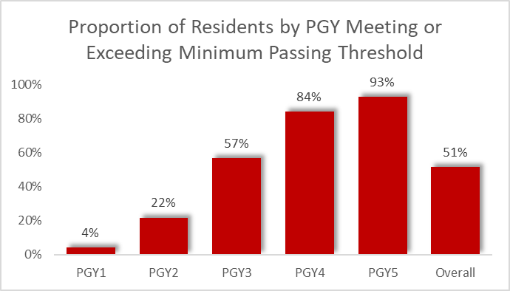
2023 OITE/ABOS Part I Linking Study
2023 ABOS Linking Study Predicted Passing Score: 165/264 (62.5% correct)

Slide 4
2023 Administration Recap
Administration Counts

Slide 5
2023 OITE Recap
Administration Enhancements for ’23
  Browser performance issues negatively effected remote examinees
  Requirement for 2 proctors per in-person test session
  Strengthening of resident and inclusion of proctor Codes of Conduct (Honor Codes)
  Expansion and revision of administration documentation for all parties
  Restricted proctors from creating new proctor records, initiating test sessions at will, and ceased the use of generic passwords
  Ceased the practice of “touchless” proctor login
  New feature for residents, OITE items link directly to ROCK chapters for easier review of content.
Notes:
Closed potential security holes and made for more effective tracking of program test sessions
Problem resolved through use of the vendor Session Management feature
All programs registered 2 proctors, but there is no reliable method to verify adherence
No reliable way to assure compliance
Greater specificity, but we can’t make them read it!

Slide 6
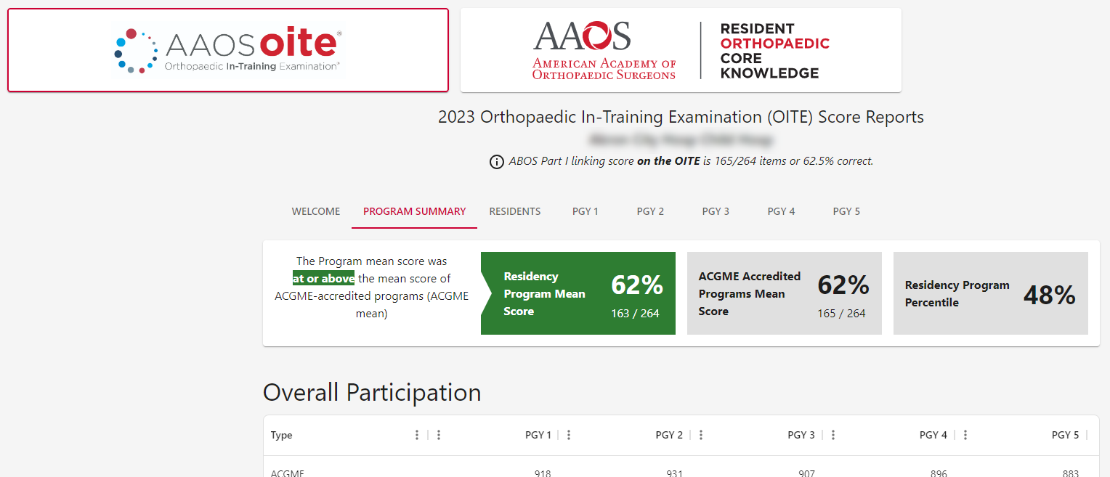
2023 Administration Recap
Score Reports for ‘23
Program score reports now online
Advanced sorting and filtering capability
Multiple-format data exporting
Targeted report printing
Ability to access both OITE and ROCK report data through the same dashboard

Slide 7
2024 Projected Enhancements
New provider of Remote Proctoring: A technical issue that caused progressively degraded performance for remote examinees during the first Friday and Saturday of the administration necessitated this change.
Access to Score Reports: No longer accessed through aaos.org account settings, will now be available via “Manage Residency Programs” tab on the AAOS LMS. (learn.aaos.org)

Slide 8


