Slide 1
Keep Calm and Carry On: Managing Crisis in GME
Cristin Hart, M.Ed.
ARCOS Annual Conference - 2024

Slide 2
Disclosure
No conflicts of interest to report

Slide 3
Objectives
Provide a base knowledge of managing unexpected & complex situations within your program/institutions
Properly strategize how to prepare for a crisis
Create action plans focused on a variety of crisis situations and the utilization of an emergency response plan

Slide 4


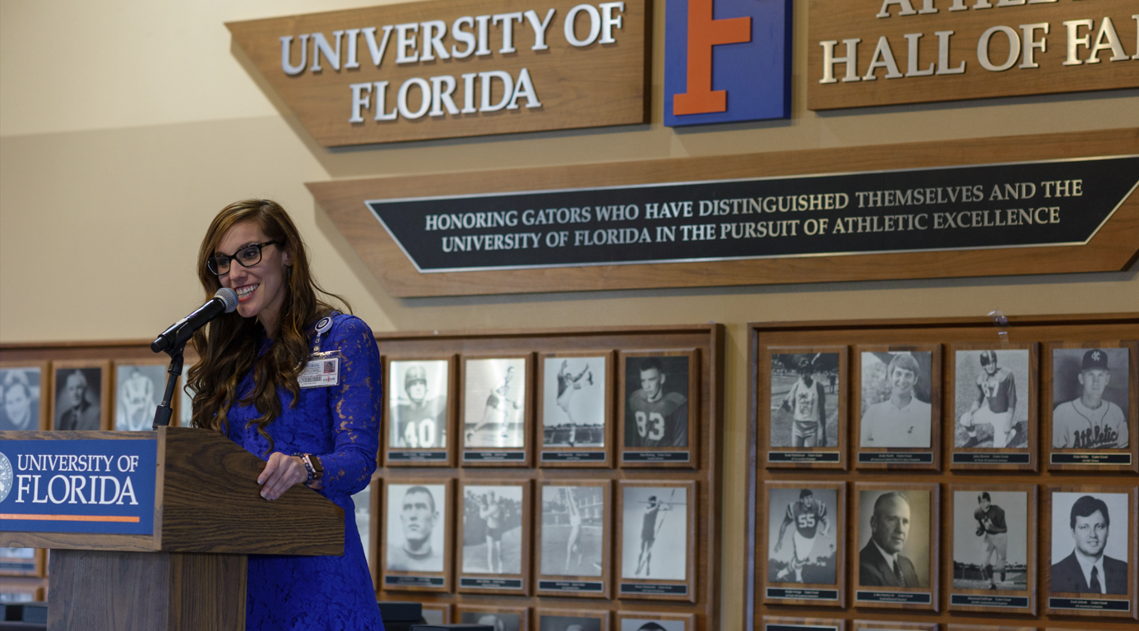
About Me
Cristin Hart, M.Ed.
National GME Director
Tenet Health
Keep Calm & Carry On; Managing Crisis in GME. Cristin Hart, M.Ed.

Slide 5
Isn’t everything a crisis?
The few years – hasn’t everyone become a crisis manager?
Coordinators are often “First Responders”
Uniqueness of Residents/Fellows
*Trigger warning

Slide 6
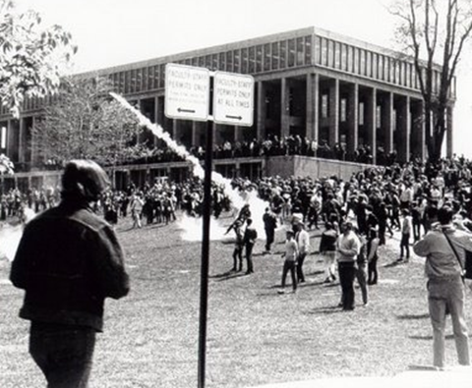
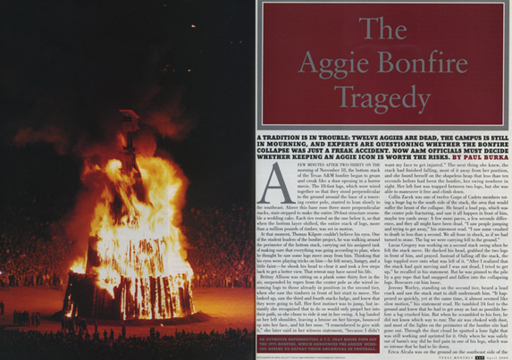

Quick History
Change Policy:
  Kent State: Invention of the swat team
  Virginia Tech: Invention of the Behavior Assessment Team
  Hartman v. Bethany College: Universities don’t have a duty to protect off campus

Slide 7
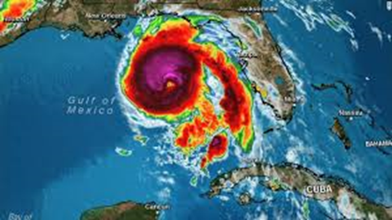

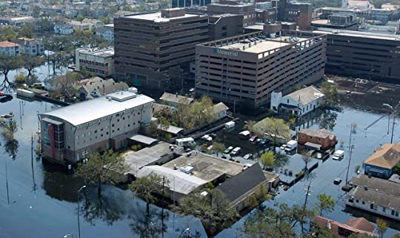
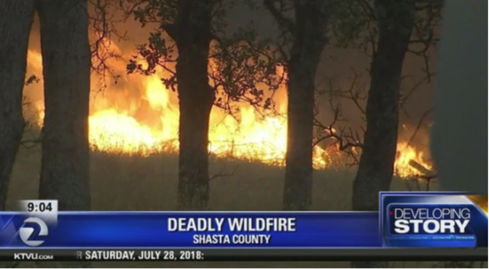
Types of crisis
Environmental
  Hurricanes, Wildfires, Pandemics
Facilities
  Fires, Floods
Human
  Everything else*

Slide 8


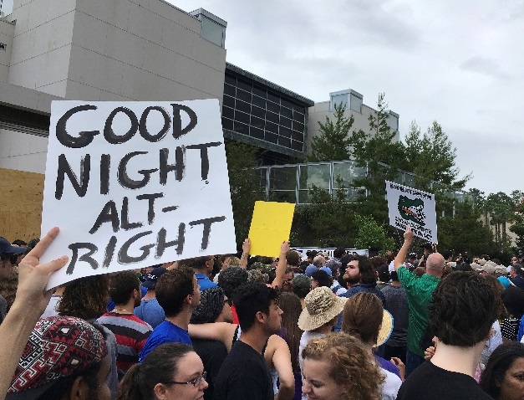
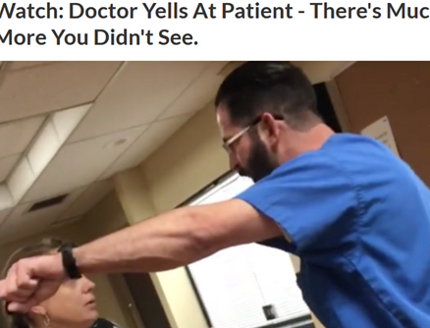
Human Crisis
Institutional
Community
Personal

Slide 9

Human-Crisis Real Scenarios
Resident shows up drunk to the ER
Husband commits suicide
Resident attempts suicide and found by peer
Resident as trauma patient treated by peers
Residents arrested for felony break-in
Resident accused of sexual misconduct
Residents injured during a wellness event
Resident in an adult film site
Resident operating while intoxicated
Resident finds a peer diverting
Mass/Active Shooting

Slide 10
Activity
What would you do?
  Resident tells attending she needs to go home because her house has been broken into
Its her peer
  Now what do you do?
Refuses to file a police report, but gets a restraining order
What happened:
  Cover the shift, offer EAP, let her go home alone
  Involves other peers- protect privacy/rumor control
  Protective Orders;
    Title IX, how do you protect education?

Slide 11
Activity
What would you do?
  Resident doesn’t come to work and isn’t answering their phone
Go to the house, no one answers
  Now what?
Resident is found dead
  What's the next 5 hours look like?
What happened:
  Going to the house
  Police Involvement
    Notifying Emergency Contact
  Importance of a policy

Slide 12

Lessons Learned
Need for a communication plan
  Use of social media
    friend and foe
  Be mindful of the multi- communications
    Hospital/university/programs
The PD will need support
Balance transparency & privacy
Emergency loans/crisis employee program
Ensure updated emergency contact info

Slide 13

Step 1: Talk about it
What can a Coordinator handle on their own?
When do to escalate?
Who are your program stakeholders?
  Chief Residents
  Program Director
  Program Admin
  Program Chair
  GME Office/DIO
  Hospital Leadership

Slide 14

Step 2: Develop Your Tool Kit
Create a Strategic Plan
  Meet with key stakeholders:
    PD, Chief Residents, Administrators
  Tiered Communication Plan
  Emergency Response Team
Create a phone tree
Align with the ACGME Policy “IV.N. Substantial Disruptions in Patient Care or Education: The Sponsoring Institution must maintain a policy consistent with ACGME Policies and Procedures that addresses support for each of its ACGME-accredited programs and residents/fellows in the event of a disaster or other substantial disruption in patient care or education. (Core)”

Slide 15
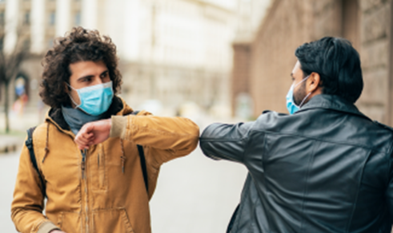
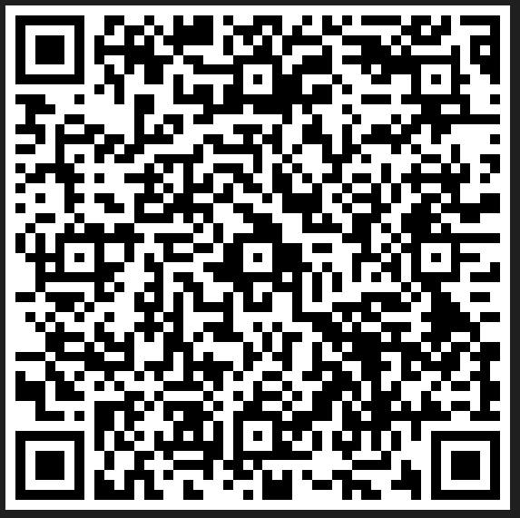

Shared Tools
QR Codes:
  Program flip charts
  Communication Plan
    Updated call lists
    Share plans with stakeholders

Slide 16

Contact Info: cristin.hart@Tenethealth.com
Questions?

