Slide 1

2024 Education Assessments and Examinations
Committee Meeting
February 14, 2024

Slide 2
Agenda
Introductions - Dr. Otsuka (remote)
Disclosures - Christina Crumlish
Acknowledgement-Retiring Members - Dr. Otsuka (remote)
Committee Requirements - Dr. Otsuka (remote)
Examination Development Process - Christina Crumlish
2023 OITE Review - David Marshall/Astrid Delaney (remote)
2023 OITE Administration Recap – David Marshall
2024 OITE Projected Enhancements– David Marshall
2024 OITE Item Review Meeting/ABOS ‘25 Item Review/ Validity – Christina Crumlish
Questions
Adjourn

Slide 3
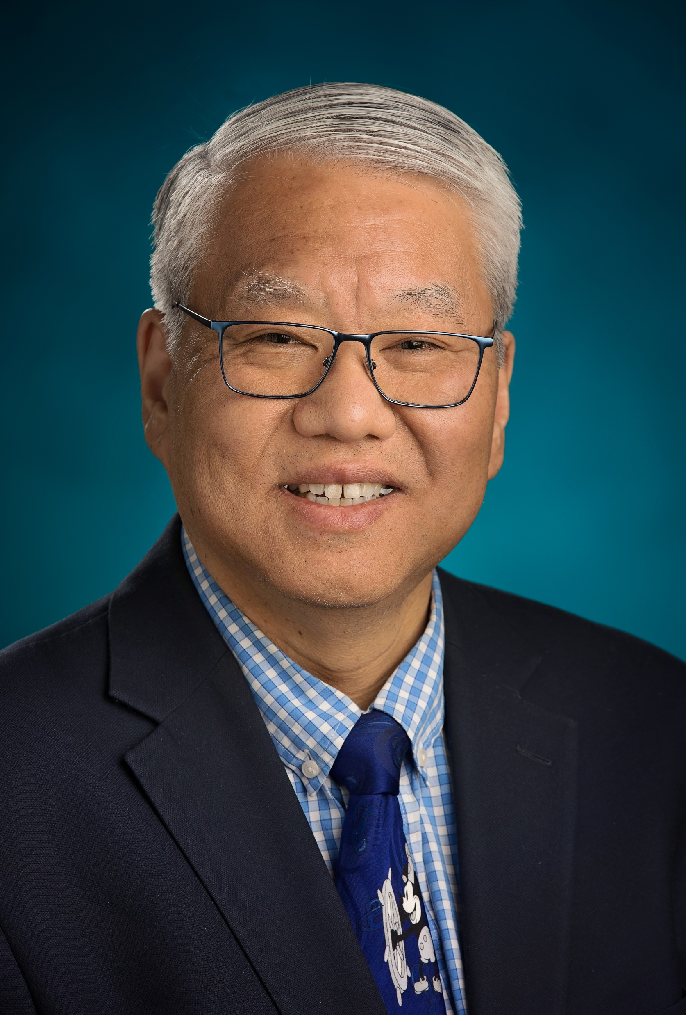
Introductions
Brian Moore
Director Learning & Practice
Irene Bogdal
Administrative Specialist
Christina Crumlish
Examinations Specialist
Astrid Delaney
Examinations Specialist
David Marshall
Manager -Assessments & Examinations
Marcie Lampert
Examinations Specialist
Anna Salt Troise
Chief Commercial Strategist
Norman Otsuka, MD
Chair

Slide 4
Disclosures
Norman Yoshinobu Otsuka, MD, FAAOS (Chair): Submitted on: 10/20/2023 AAOS: Board or committee member ACGME: Board or committee member Journal of Children's Orthopaedics: Editorial or governing board Journal of Orthopaedic Surgical Advances: Editorial or governing board Journal of Pediatric Orthopedics: Editorial or governing board Journal of Pediatric Orthopedics, Part B: Editorial or governing board Journal of the American Academy of Orthopaedic Surgeons: Editorial or governing boa
Lauren Crocco, MD, FAAOS (Member): Submitted on: 05/10/2023
AAOS: Board or committee member
Syker: Paid Consultant
Zimmer: Paid consultant
David Samuel Geller, MD, FAAOS, FACS (Member): Submitted on: 11/11/2023
AAOS: Board or committee member
Curi Science: Paid presenter or speaker
Musculoskeletal Tumor Society: Board or committee member
Osteocentric: Paid consultant
Stryker: Paid consultant
Ayesha Abdeen, MD, FAAOS (Member): Submitted on: 03/07/2023 AAOS: Board or committee member American Association of Hip and Knee Surgeons: Board or committee member Brixton Biosciences: Stock or stock Options DePuy, A Johnson & Johnson Company: Paid consultant Smith & Nephew: Paid consultant
Chancellor Folsom Gray, MD, FAAOS (Member): Submitted on: 04/27/2023
AAOS: Board or committee member
Debogy Molecular: Stock or stock Options
Pivot MedTech: Paid consultant
ROM3: Stock or stock Options
Smith & Nephew: Paid consultant; Paid presenter or speaker
Jamal Al‑Asiri, MD, FAAOS, FACS, FRCSC: (This individual reported nothing to disclose); Submitted on: 04/15/2023
Amit Ketan Bhandutia, MD, FAAOS: Submitted on: 10/23/2023
4WEB Medical: Paid consultant
Zavation: Paid consultant
Claire Francis Beimesch, MD, FAAOS (Member): Submitted on: 10/30/2023
AAOS: Board or committee member
American Academy for Cerebral Palsy and Developmental Medicine: Board or committee member
Pediatric Orthopaedic Society of North America: Board or committee member
Christina Kay Hardesty, MD, FAAOS: Submitted on: 10/20/2023
Medtronic: Paid consultant
OrthoPediatrics: IP royalties; Paid consultant
Gregory P Harvey, MD, FAAOS: (This individual reported nothing to disclose); Submitted on: 10/27/2023
Brian Michael Haus, MD, FAAOS (Member): Submitted on: 06/01/2023
AAOS: Board or committee member
American Orthopaedic Society for Sports Medicine: Board or committee member
Yelena Bogdan, MD, FAAOS, FACS (Member): Submitted on: 10/20/2023
AAOS: Board or committee member
Orthopaedic Trauma Association: Board or committee member
Smith & Nephew: Paid consultant
Brian E Brigman, MD, PhD, FAAOS (Member): Submitted on: 05/31/2023
Daiichi Sankyo: Paid consultant
Daiichi‑Sankyo: Paid presenter or speaker
Journal of Surgical Oncology: Editorial or governing board
Lumicell Diagnostics: Research support
Musculoskeletal Transplant Foundation: Paid consultant; Paid presenter or speaker; Research support
Musculoskeletal Tumor Society: Board or committee member
Stuart H Hershman, MD, FAAOS, FAOrthA (Member): Submitted on: 04/24/2023
AAOS: Board or committee member
Biocomposites: Paid presenter or speaker
Cervical Spine Research Society: Board or committee member
North American Spine Society: Board or committee member
Nuvasive: Paid presenter or speaker
OnPoint Surgical: Stock or stock Options
Scoliosis Research Society: Board or committee member
John William Hinchey, MD, FAAOS (Member): Submitted on: 05/05/2023
AAOS: Board or committee member
DJ Orthopaedics: Other financial or material support
ROM 3: Stock or stock Options
Texas Orthopaedic Association: Board or committee member
Texas Orthopaedic Political Action Committee: Board or committee member
Seth A Cheatham, MD, FAAOS (Member): Submitted on: 10/23/2023
AAOS: Board or committee member
American Orthopaedic Society for Sports Medicine: Board or committee member
Arthroscopy Association of North America: Board or committee member
Virginia Orthopaedic Society: Board or committee member

Slide 5
Disclosures (cont.)
John G Horneff III, MD, FAAOS (Member): Submitted on: 05/17/2023
AAOS: Board or committee member
American Shoulder and Elbow Surgeons: Board or committee member
Catalyst: Paid consultant
OREF: Research support
Phoenix Shoulder Society: Board or committee member
Springer Nature: Publishing royalties, financial or material support
Tigon: Paid consultant
James Benjamin Jackson III, MD, MBA, FAAOS (Member): Submitted on: 04/07/2023
AAOS: Board or committee member
American Orthopaedic Association: Board or committee member
American Orthopaedic Foot and Ankle Society: Board or committee member
Journal of Surgical Orthopaedic Advances: Editorial or governing board
Marci Dara Jones, MD, FAAOS (Member): Submitted on: : 05/12/2023
AAOS: Board or committee member
American Orthopaedic Association: Board or committee member
Orthopaedic Research and Education Foundation: Board or committee member
Niranjan Kavadi, MD, FAAOS (Member): Submitted on: 05/19/2023
Alphatec Spine: Stock or stock Options
North American Spine Society: Board or committee member
SpineLine: Editorial or governing board
Brian C Law, MD, FAAOS (Member): Submitted on: 05/12/2023
AAOS: Board or committee member
Abbott: Stock or stock Options
American Orthopaedic Foot and Ankle Society: Board or committee member
Amgen Co: Stock or stock Options
DJ Orthopaedics: Paid consultant; Paid presenter or speaker
Eli Lilly: Stock or stock Options
Johnson & Johnson: Stock or stock Options
Journal of Surgical Education: Editorial or governing board
Medtronic: Stock or stock Options
Merck: Stock or stock Options
Stryker: Paid consultant; Paid presenter or speaker
Wisconsin Orthopaedic Society: Board or committee member
Zimmer: Research support
Raymond W Liu, MD, FAAOS (Member): Submitted on: 10/21/2023
AAOS: Board or committee member
Journal of Pediatric Orthopedics: Editorial or governing board; Publishing royalties, financial or material support
Limb Lengthening and Reconstruction Society (LLRS): Board or committee member
Orthopediatrics Royalties paid to my university: IP royalties
Pediatric Orthopaedic Society of North America: Board or committee member
Kathleen A McHale, MD, FAAOS (Member): Submitted on: 05/26/2023
AAOS: Board or committee member
Stephanie J Muh, MD, FAAOS: Submitted on: 12/18/2023
Arthrex, Inc: Paid consultant
DePuy, A Johnson & Johnson Company: Paid consultant
Exactech, Inc: Paid consultant; Research support
Smith & Nephew: Research support
Jon Edward Oda, MD, FAAOS (Member): (This individual reported nothing to disclose); Submitted on: 05/19/2023
Alexander Payatakes, MD, FAAOS (Member): Submitted on: 05/05/2023
AAOS: Board or committee member
American Society for Surgery of the Hand: Board or committee member
Ricky J Placide, MD, FAAOS (This individual reported nothing to disclose); Submitted on: 04/14/2023
Nicholas Pulos, MD, FAAOS (Member): Submitted on: 04/17/2023
Trimed: Paid presenter or speaker
Raveesh D Richard, MD, FAAOS (Member): Submitted on: 04/06/2023
AAOS: Board or committee member
European Journal of Orthopaedic Surgery and Traumatology (EJOST): Editorial or governing board
Orthopedic Trauma Association International (OTAI) Journal: Editorial or governing board
Stryker: Paid consultant; Paid presenter or speaker
Jessica C Rivera, MD, PhD, FAAOS (Member): Submitted on: 04/14/2023
AAOS: Board or committee member
AAOS Now: Editorial or governing board
Bioventus: Paid consultant
Limb Lengthening and Reconstruction Society: Board or committee member
Orthopaedic Research Society: Board or committee member
Fernando Leon Sanchez, MD, FAAOS (Member): Submitted on: 04/14/2023
Medacta: IP royalties; Paid consultant; Paid presenter or speaker

Slide 6
Disclosures (cont.)
Jeremy S Somerson, MD, FAAOS (Member): Submitted on: 04/07/2023
AAOS: Board or committee member
Advances in Radiation Oncology: Editorial or governing board
American Shoulder and Elbow Surgeons: Board or committee member
American Society for Radiation Oncology: Board or committee member
Charles Su, MD, PhD: (This individual reported nothing to disclose); Submitted on: 05/30/2023
Nicholas S Tedesco, DO, FAAOS: Submitted on: 04/06/2023
AAOS: Board or committee member
Doctorpedia: Stock or stock Options
Journal of the American Osteopathic Academy of Orthopedics: Editorial or governing board
Medscape: Publishing royalties, financial or material support
Musculoskeletal Tumor Society: Board or committee member
RomTech, Inc.: Stock or stock Options
Harmeeth Singh Uppal, MD (Member): Submitted on: 05/08/2023
AAOS: Board or committee member
AO Trauma: Board or committee member
Orthopaedic Trauma Association: Board or committee member
Brian C Werner, MD, FAAOS (Member): Submitted on: 12/07/2023
AAOS: Board or committee member
American Orthopaedic Society for Sports Medicine: Board or committee member
American Shoulder and Elbow Surgeons: Board or committee member
Arthrex, Inc: Paid consultant; Paid presenter or speaker; Research support
Biomet: Research support
Exactech, Inc: Research support
Flexion Therapeutics: Research support
Henock T Wolde Semait, MD, FAAOS: (This individual reported nothing to disclose); Submitted on: 04/14/2023
David Marshall (Staff Liaison): (This individual reported nothing to disclose); Submitted on: 06/07/2023
Christina Crumlish (Assistant Staff Liaison): (This individual reported nothing to disclose); Submitted on: 02/21/2023
Astrid Delaney: (This individual reported nothing to disclose); Submitted on: 02/21/2023

Slide 7



Retiring Members
• Shahryar Ahmadi, MD, FAAOS (Shoulder & Elbow)​
• Matthew Baker, MD, FAAOS (Shoulder & Elbow)
• Stephen John Becher, MD, FAAOS (Trauma)
• Andrew Moon Choo, MD, FAAOS (Trauma)
• James Matthew Gregory, MD, FAAOS (Shoulder & Elbow)
• Michael S Kain, MD, FAAOS (Trauma)
• Michael S Khazzam, MD, FAAOS (Shoulder & Elbow)
• E Scott Paxton, MD, FAAOS (Shoulder & Elbow)
• Zeeshan Mohammad Sardar, MD, FAAOS (Spine)
• Mark Schultzel, MD, FAAOS (Shoulder & Elbow)
• Edward J Shields, MD, FAAOS (Shoulder & Elbow)
• M Alvarado, MD, FAAOS (Basic Science)​
• Seth A Cheatham, MD, FAAOS (Sports Med)​
• Kathleen A. McHale, MD, FAAOS (Pediatrics)​
• Jon Oda, MD, FAAOS (Pediatrics)
• Fernando Leon Sanchez, MD, FAAOS (Hip & Knee)​
•Ilyas Aleem, MD, FAAOS (Spine)
•Tyler Jaames Brolen, MD, FAAOS (Shoulder & Elbow)
•Sean P Kelly, MD, FAAOS (Basic Science)​
•Sav Shah, MD, FAAOS (Shoulder & Elbow)
A sincere thank you for sharing your time and expertise!

Slide 8
Functions of Committee Members
Obligations of evaluation committee member participation:
  Committee members are expected to complete the entire 3-phase examination development cycle within the specified project time frames:
    Item Writing - develop and submit the designated number of items based on the assigned blueprint topic areas.
    Peer Review - the process of reading assigned examination items and providing constructive critique and feedback.
    Item Review Meeting - a 1-day in-person meeting with other committee members to discuss and make final edits of the examination items.
    Following the completion of these phases, the member must complete and submit an activity evaluation survey (a requirement of all CME programs); after which, up to 10 CME credits will be awarded.

Slide 9









Examination Development Process
Items Assigned to Committee Members
Items Revised
AAOS Style
Items and Images
Submitted
Peer Review
Comments
Documented
Medical Editing
Item Selection for Exam
Review Meetings-Committee
Reviews Comments and Meet in Small Groups to edit current OITE and revalidate ABOS items
Final Item Review
Exam Approved for Publication

Slide 10


ABOS Part I/OITE Linking Study
The American Board of Orthopaedic Surgery (ABOS) and the American Academy of Orthopaedic Surgeons (AAOS) collaborated on the development of a collection of examination items that were included on both the 2023 ABOS Part I Certifying Examination and the 2023 AAOS OITE.
The purpose of including a set of common items on both examinations is to identify the score on the OITE that approximately corresponds to the minimum passing performance level on the ABOS Part I Certifying Examination.
Based on the linking study, a score of 165 or 62.5% on the OITE corresponded to the minimal passing standard on the ABOS Part I Certifying Examination.

Slide 11
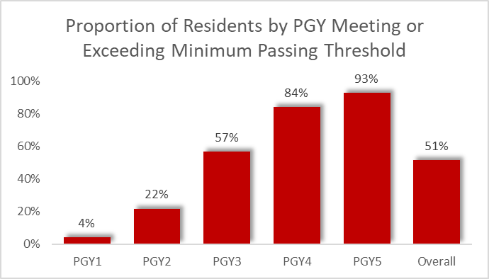
2023 OITE/ABOS Part I Linking Study
2023 ABOS Linking Study Predicted Passing Score: 165/264 (62.5% correct)

Slide 12
2023 Administration Highlights
819 (93%) of 2023 ACGME PGY 5 residents met the passing threshold, compared to 753 (84%) meeting 2022’s threshold
Programs opting for remote testing has increased for the first time since 2020
Notes:
4,942 residents in 2020
228 programs in 2020
40%/60% in-person vs. remote

Slide 13
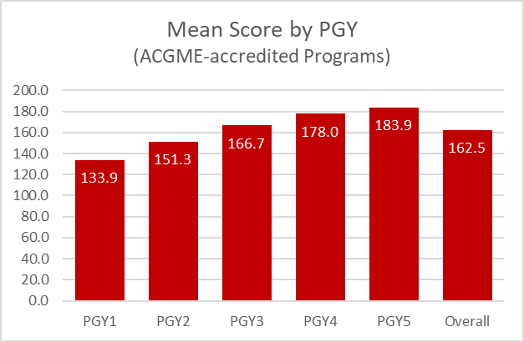
2023 Overall Results
(All residents)
ACGME-accredited programs compared to Non-ACGME
Mean Score by PGY: ACGME-Accredited Programs

Slide 14
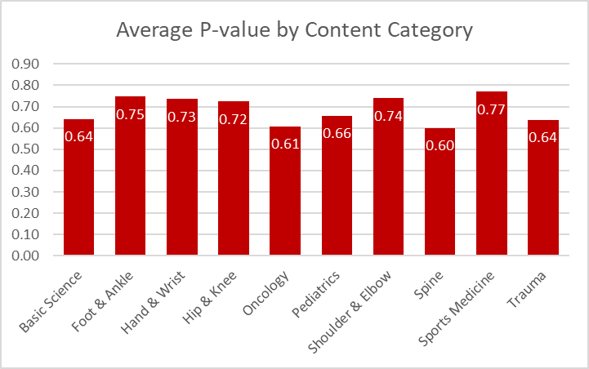
Item Difficulty: Content Areas
(ACGME residents)
Easier
Harder

Slide 15
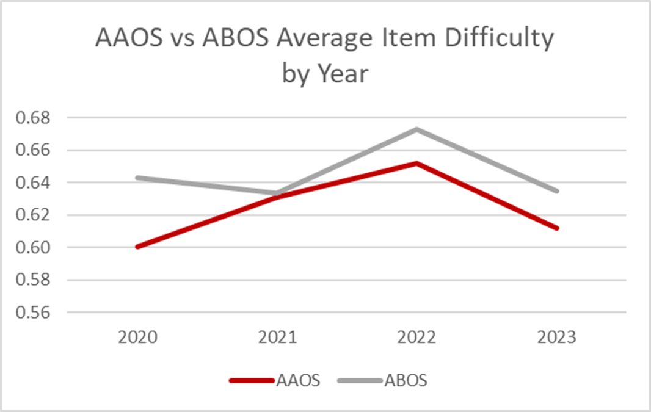
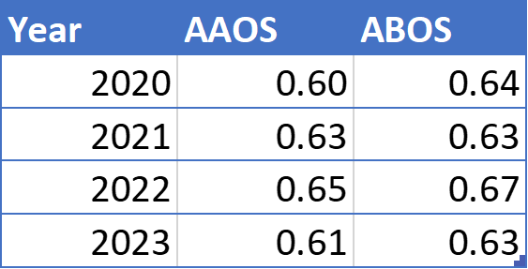
2020-23 OITE/ABOS Item Performance Comparison
Overall Average P-Value of Items
(% of Residents who answered correctly)
ABOS items are consistently slightly easier, however there is not a statistically significant difference

Slide 16
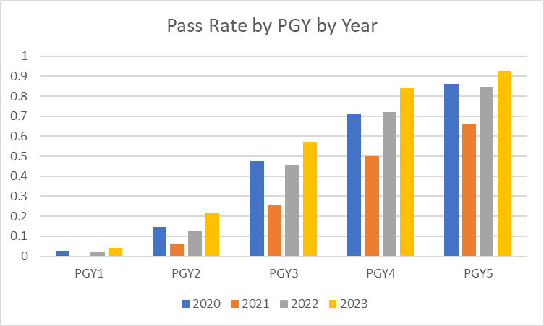
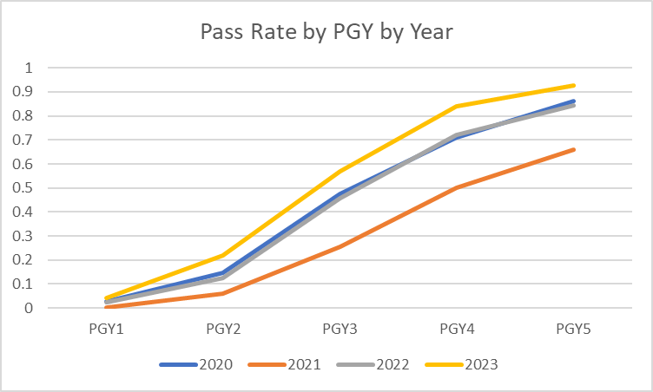
4-Year Analysis: Pass Rates
(ACGME residents)
Notes:
2021 was an outlier for ABOS as well

Slide 17
2023 OITE Recap
Administration Enhancements for ‘23
  Browser performance issue negatively effected remote examinees’ testing experience
  Requirement for 2 proctors per in-person test session
  Strengthening of resident and inclusion of proctor Codes of Conduct (Honor Codes)
  Expansion and revision of administration documentation for all parties
  Restricted proctors from creating new proctor records, initiating test sessions at will, and ceased the use of generic passwords
  Ceased the practice of “touchless” proctor login
  New feature for residents. OITE items link directly to ROCK chapters for easier review of content.
Notes:
Closed potential security holes and made for more effective tracking of program test sessions
Problem resolved through use of the vendor Session Management feature
All programs registered 2 proctors, but there is no reliable method to verify adherence
No reliable way to assure compliance
Greater specificity, but we can’t make them read it!

Slide 18
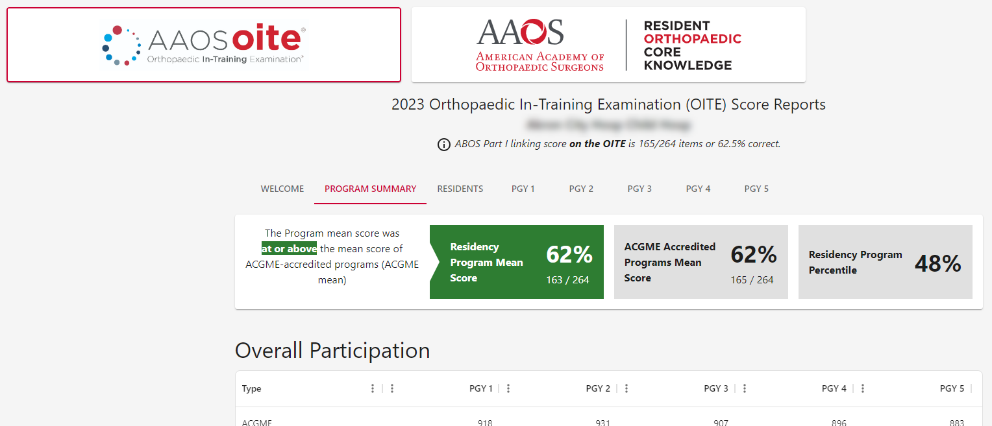
2023 OITE Recap
Score Reports for ‘23
Program score reports now online
Advanced sorting and filtering capability
Multiple-format data exporting
Targeted report printing
Ability to access both OITE and ROCK report data through the same dashboard

Slide 19
2024 OITE Projected Enhancements
New provider of Remote Proctoring: A technical issue that caused progressively degraded performance for remote examinees during the first Friday and Saturday of the administration necessitated this change.
Access to Score Reports: No longer accessed through aaos.org account settings, will now be available via “Manage Residency Programs” tab on the AAOS LMS (learn.aaos.org)

Slide 20





2024 Self-Assessment Exam Releases

Slide 21
2024 Assessments & Examinations Initiatives
OSIE Product Portfolio:
  Exploring development of dynamic content exam content
  Evaluating restructuring of present exam products’ development and release schedule
Revalidation of Expired Items:
  Confirm current validity and relevance
  Recertify CME/SAE eligibility
Item Bank Evaluation:
  RFP to be distributed by end of February
  Selection to be made by end of April

Slide 22
2024 Item Review Meeting
Date: Friday, April 12th
Time: 8:00 am to 4:00 pm
Primary task will be to evaluate (and modify as needed) questions for inclusion on the OITE examination
Second half of day will be spent reviewing the 2020 ABOS items for inclusion on the 2025 OITE. This will be the only chance to edit items, update references as needed, or remove items. They will be combined with the ABOS Ad-hoc items – then banked again for another 5 years (2030).
Not all questions are accepted for inclusion, so it is important to have more than needed to choose from (particularly Trauma, Foot & Ankle, Pediatrics, Spine, Hip & Knee, Sports, and Basic Science)
This will be our final chance to prepare items for the 2024 OITE examination.
Come to the meeting with the expectation of spending the full day of reviewing questions.
Please RSVP to Irene Bogdal (bogdal@aaos.org) as soon as possible accurate headcounts help us to stay within budget

Slide 23


Slide 24


