Slide 1
BOS Fellowship Committee Update
Scott Steinmann, MD
Emeritus Professor of Orthopedic Surgery Mayo Clinic

Slide 2
Disclosure
I (and/or my co-authors) have something to disclose. Detailed disclosure information is available via: The course syllabus, or AAOS Disclosure Program on the AAOS website at http://www.aaos.org/disclosure

Slide 3
Fellowship Oversight Committee
Scott Steinmann, MD (Chair)
Jeff Dugas(Vice-Chair)
Sports Medicine
John Richmond, MD
Arthroscopy
Elizabeth Gausden, MD
Adult Reconstruction
Andrew Schoenfeld, MD
Spine
Jeremy J McCormick, MD
Foot and Ankle
Dawn Laporte, MD
Hand
Michael Weaver, MD
Trauma
Santiago Andres Lozano Calderon, MD
Musculoskeletal Tumor
Thomas Wright, MD
Shoulder and Elbow
Meghan N Imrie, MD
Pediatrics
Armando Vidal, MD
AAOS BOS Chair
Staff Liaisons
Ellen Bushong
Evette Thompson, MA, CDF, CCC
Donna Malert, CAE
Yasseline Knoke, MS, CAE

Slide 4
AAOS BOS Fellowship Committee Charges
Oversight of fellowship issues as they arise
Input into accreditation / recognition issues
Assistance with educational objectives
Post-fellowship surveys
Code of Conduct updated
Ensure fair process for applicants

Slide 5
Current Single Match Day
Background:
2019 was the first Single Fellowship Match
All specialties except hand surgery
Uniform Application and requested materials
Application
CV
Three Letters of Reference
All specialties, except Hand, currently use SF match for fellowship match
Hand (NMRP)
Applicants can apply to, and rank, programs in different specialties and the best match applies

Slide 6
2024 Match Update
Adult Reconstruction and Hand surgery interest continues to increase
Sports medicine still has most positions
Other specialties remaining mostly steady from prior years
90-95% of graduating residents matriculating to a fellowship year
Slight decline of FMG’s

Slide 7
preliminary match data
 | 2024* | 2023 | 2022
positions | 951 | 921 | 904
programs | 505 | 498 | 480
applicants | 998 | 975 | 972
Slide from Dennis Thomatos

Slide 8
2024
Demographic Data
166 females registered vs. 139 last year
Males /Female ratio small uptick in female registrants currently 16% vs. 14 % last year
Foreign applicant pool about the same 170 registered in 2024
-similar Canadian registrants 24 this year and 32 last year
Slide from Dennis Thomatos

Slide 9
SF Match Summary
Match system performing well
More infrastructure upgrades to allow increased capacity.
Society portal finally coming online in 2024. Will allow subspecialty society managers to self manage data counts.
276 programs list in In-Person Interviews.
Match Rules and society code of conduct were updated from all that provided to SF Match
Slide from Dennis Thomatos

Slide 10
Match 2024
Match dates
April 9th rank list due from applicants and programs
April 16th match results released
April 17th post match vacancies announced

Slide 11
Current Match Data 2023-24
Program Data |  | Applicant Data
Positions | 934 | Registered | 699
Programs | 496

Slide 12
Past Match Data
 | April 2021 | April 2022 | April 2023
Applicants Registered | 974 | 961 | 985
Applicants Applied | 915 | 917 | 942
Male/Female Registered(%) | 88% / 12% | 86% / 13% | 85% / 14%
Pos Offered | 904 | 924 | 915
Programs Participating | 456 | 480 | 477

Slide 13
Applicant Data

Slide 14
Specialty Data
Notes:
About 180 Hand Positions

Slide 15
2022 Subspecialty Data
8 applicants (all foreign medical school grads) applied to all subspecialties.
36 applied to sports/hip and knee and all are foreign
26 applied to foot/ankle and Trauma and all are foreign

Slide 16
2023 vs. 2022 preliminary match data
 | 2023 | 2022
positions | 921 | 904
programs | 498 | 480
applicants | 975 | 972
Data provided by SF Match

Slide 17
2023
Demographic Data
139 females registered vs. 131 last year
Males /Female ratio about the same
Foreign applicant pool about the same
-fewer Canadians in 2023 <10 vs. 27 last year

Slide 18
Summary
Match system performing well Infrastructure upgrades since last year improved our availability during regional provider outages
Hybrid Model of interviews working 330 programs recorded dates through the system
Match Rules and society code of conduct provided during registration

Slide 19
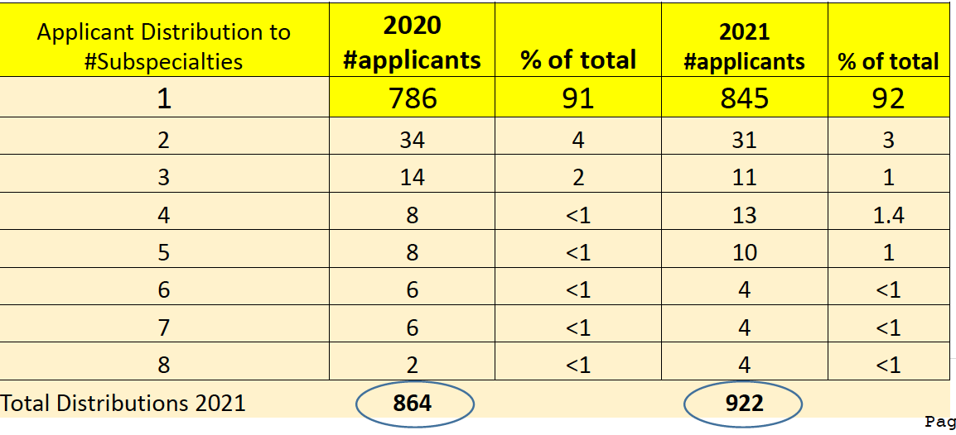
Applicant Data 2022
Applicant pool is larger 969 (47 more than 2021)
• 92% apply to one subspecialty – stable
• Applicants applied to average of about 30 programs
.

Slide 20
Programs and Positions offered
Overall:
16 new fellowship programs in SF Match
20 new fellowship positions available

Slide 21
Applicant Trends

Slide 22
Programs and Positions 2022

Slide 24
Positions Filled

Slide 25
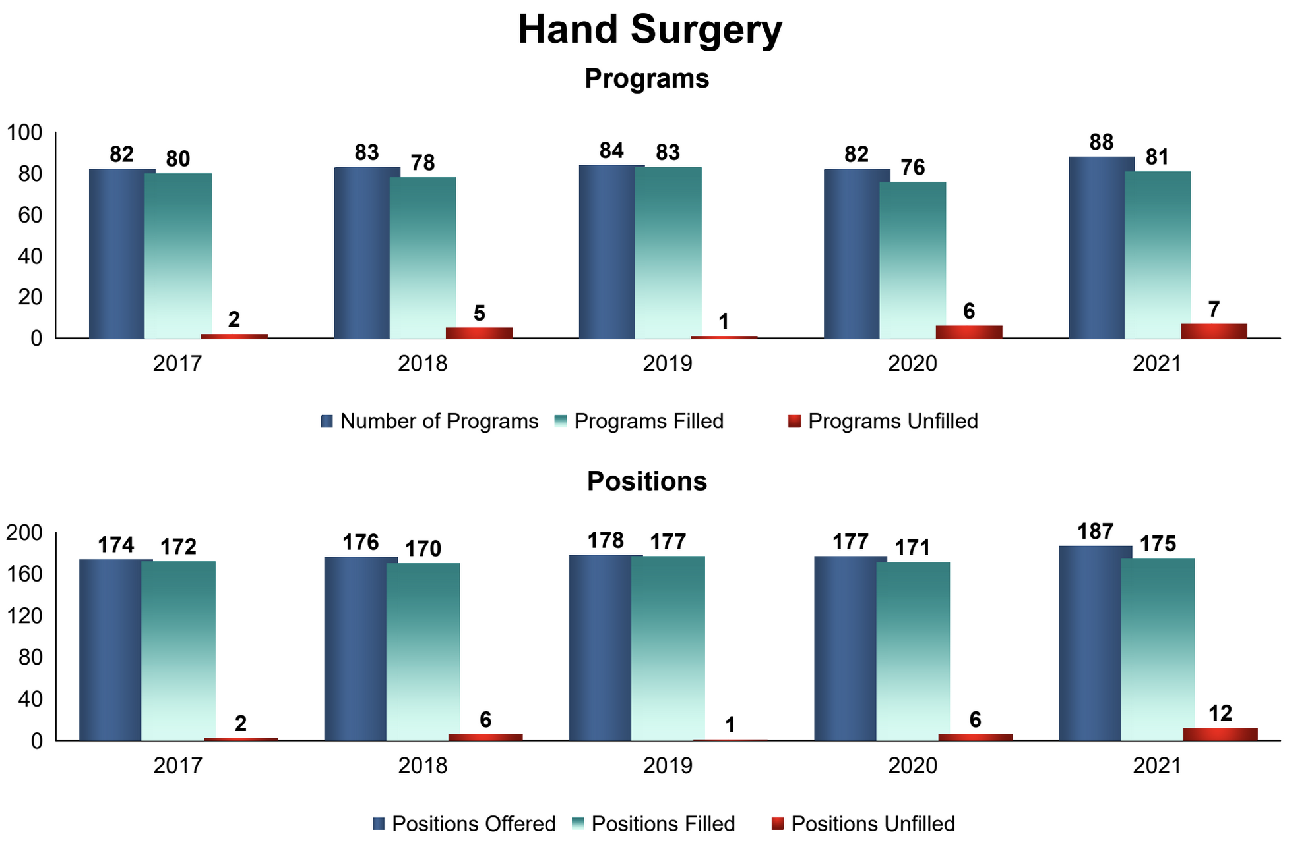
Hand Surgery Match NMRP

Slide 26
Matched Applicants and Number of Applications

Slide 27
Most applicants apply to one specialty

Slide 28
ACGME programs

Slide 29
Code of Conduct
Deterrents to Match violations

Slide 30
Code of Conduct in place since 2019:
Nothing about consequences or sanctions if a violation occurs

Slide 31
Code of Conduct – Addition of Possible Sanctions
Focused mainly on the programs
Less focused on the applicant – letter to residency program director

Slide 33
Only the applicants are warned of consequences not the programs currently

Slide 34
Accreditation
Hand and Sports Medicine
Specialty certificate through ABOS
ACGME
Pediatrics, Trauma, Shoulder / Elbow
Society driven accreditation programs
Fellowship program criteria
Case log monitoring
Adult Reconstruction, Foot/Ankle, Spine, Musculoskeletal Tumor
In varying stages of interest and exploration

Slide 35
What’s on the horizon for 2023-24 and beyond?
Code of Conduct updated this year
Accreditation process continues: Trauma, Peds, Shoulder/Elbow (completed) - Adult Reconstruction, Foot/Ankle, and Spine (in progress)
In 2021 all interviews were all virtual (in line with AAMC policies for residency interviews)
In person interviews are back, but virtual serves a role and will continue in the future (however “interview hoarding” an issue with virtual for top tier applicants)
Further discussion of “Preference Signaling” for applicants to programs
Ongoing discussion of skills assessment
Notes:
Residency match rate 64% in 2022, number of applications per applicant increased from 46 to 86.
Allopathic senior med students 14 – 16 interviews
Step 1 going pass fail makes it harder. Ortho residencies allow 30 “signals” in the match derm and gen surg 3 – 5 signals, applicants who signal has 24% chance of interview
1% if they did no signal. Virtual residency interviews saved average of $5000 per applicant. Some residencies got 1000 applicants any may put in a lot of filters that may
Hurt diversity Match 2024 fellowship: April 9th deadline, April 16th results

Slide 36
BOS
Support is integral since specialty societies are integrated deeply into fellowship education
Zoom meetings over the past year, but good to have face to face meetings
AAOS Sept 2021
AAOS March 2022
BOS great help to distribute information from fellowship committee to fellowship programs and applicants

Slide 37
Thank You
steinmann.scott@mayo.edu
Cell: 507-358-3610

Slide 38
Disclosure
I (and/or my co-authors) have something to disclose. Detailed disclosure information is available via: The course syllabus, or AAOS Disclosure Program on the AAOS website at http://www.aaos.org/disclosure

Slide 39
Fellowship Oversight Committee
Scott Steinmann, MD (Chair)
Jeff Dugas(Vice-Chair)
Sports Medicine
John Richmond, MD
Arthroscopy
Michael Taunton, MD
Adult Reconstruction
Andrew Schoenfeld, MD
Spine
John Campbell, MD
Foot and Ankle
Dawn Laporte, MD
Hand
Michael Weaver, MD
Trauma
Raffi Avedian, MD
Musculoskeletal Tumor
Thomas Wright, MD
Shoulder and Elbow
Marcella Woiczik, MD
Pediatrics
Alexe Page, MD
AAOS BOS Chair
Kevin Plancher, MD
AAOS BOS Past - Chair
Staff Liaisons
Ellen Bushong
Evette Thompson, MA, CDF, CCC
Donna Malert, CAE
Yasseline Knoke, MS, CAE

Slide 40
AAOS BOS Fellowship Committee Charges
Oversight of fellowship issues as they arise
Input into accreditation / recognition issues
Assistance with educational objectives
Post-fellowship surveys
Ensure fair process for applicants

Slide 41
Single Match Day Update
Background:
2019 was the first Single Fellowship Match
All specialties except hand surgery
Uniform Application and requested materials
Application
CV
Three Letters of Reference
All specialties, except Hand, currently use SF match for fellowship match
Hand (NMRP)
Applicants can apply to, and rank, programs in different specialties and the best match applies

Slide 42
2023 Match Update
Adult Reconstruction and Hand surgery interest continues to increase
Sports medicine still has most positions
Other specialties remaining mostly steady from prior years
Male/Female (99% registered) 86%/13%
90-95% of graduating residents matriculating to a fellowship year
Slight decline of FMG’s

Slide 43
2023 vs. 2022 preliminary match data
 | 2023 | 2022
positions | 921 | 904
programs | 498 | 480
applicants | 975 | 972
Data provided by SF Match

Slide 44
2023
Demographic Data
139 females registered vs. 131 last year
Males /Female ratio about the same
Foreign applicant pool about the same
-fewer Canadians in 2023 <10 vs. 27 last year

Slide 45
Summary
Match system performing well Infrastructure upgrades since last year improved our availability during regional provider outages
Hybrid Model of interviews working 330 programs recorded dates through the system
Match Rules and society code of conduct provided during registration

Slide 46
Applicant Data 2022
Applicant pool is larger 969 (47 more than 2021)
• 92% apply to one subspecialty – stable
• Applicants applied to average of about 30 programs
.

Slide 47
Programs and Positions offered
Overall:
16 new fellowship programs in SF Match
20 new fellowship positions available

Slide 48
Applicant Trends

Slide 49
Programs and Positions 2022

Slide 51
Positions Filled

Slide 52
Hand Surgery Match NMRP

Slide 53
Matched Applicants and Number of Applications

Slide 54
Most applicants apply to one specialty

Slide 55
Code of Conduct
Modification Discussion
Deterrents to Match violations

Slide 56
Code of Conduct in place since 2019:
Nothing about consequences or sanctions if a violation occurs

Slide 58
Only the applicants are warned of consequences not the programs currently

Slide 59
ACGME

Slide 60
ACGME programs

Slide 61
Accreditation
Hand and Sports Medicine
Specialty certificate through ABOS
ACGME
Pediatrics, Trauma, Shoulder / Elbow
Society driven accreditation programs
Fellowship program criteria
Case log monitoring
Adult Reconstruction, Foot/Ankle, Spine, Musculoskeletal Tumor
In varying stages of interest and exploration

Slide 62
ACGME: What’s Been happening over the last year?
Hand and Sports have continued to be 100% accredited through ACGME, and all programs have achieved and maintained accreditation through the most recent annual cycle.
Remaining 8 societies/fellowship concentrations have not materially changed in terms of number or % of programs seeking ACGME accreditation.
Essentially status quo from the standpoint of ACGME.
Slide from Jeff Dugas

Slide 63
Changes to requirements for Accreditation
Programs directors/coordinators and DIO’s should check the ACGME website for:
Block Schedule input
Block Rotation Schedules must be input annually for each program
Different input fields for each specialty
Requirements for Program Coordinator time/financial resources to support program
Dedicated time and pay must be recorded for the program coordinator position
Slide from Jeff Dugas
Notes:
Designated Institutional Officials (DIO

Slide 64
New RRC Director Corey Parker
Corey has now been in position for nearly 2 years.
Background in orthopedic surgery clinical and surgical
Understands the administrative burden of accreditation and is making efforts to decrease this burden.
Has been instrumental in creating “calm” around accreditation rather than “defcon 5”.
Highly encourage those willing to discuss ACGME accreditation to reach out to him and see how he can help.
Slide from Jeff Dugas
Notes:
Pam Derstine

Slide 65
What’s on the horizon for Fellowships 2022- 23 and beyond?
In 2021 all interviews were all virtual in line with AAMC policies for residency interviews
The Committee met in 2022 and determined each specialty will have a uniform decision by specialty (in person or virtual only)
In person interviews are back, but virtual serves a role and will continue in the future
Rank List Deadline: Tuesday, April 11, 2023
Match results: Tuesday, April 18, 2023
Post-match vacancies: Wednesday, April 19, 2023
Training to begin: July /August 2024

Slide 66
BOS
Support is integral since specialty societies are integrated deeply into fellowship education
Zoom meetings over the past year, but good to have face to face meetings
AAOS Sept 2021
AAOS March 2022
BOS great help to distribute information from fellowship committee to fellowship programs and applicants

Slide 67
Thank You
steinmann.scott@mayo.edu
Cell: 507-358-3610

