Slide 1
Managing Expectations:
Program Director, Residents, Medical Students / Rotators, Yourself
Patsi Furr Coordinator Spotlight Presentation

Slide 2
What Does it Mean to Manage Expectations?
Managing expectations means communicating so that all involved have a clear understanding of what to expect-and when to expect it.
It also requires keeping lines of communication open.
Notes:
For myself, managing expectations is personal and I’m sharing what I have found to work for me over the course of my 30+ years in GME between Ob/Gyn and Orthopaedics.
I think the communication factor is the key as I think you’ll see.

Slide 3
How do you Set & Manage / Communicate Expectations?
Do you have Expectations for the Following?
Yourself
PD
Residents
Students / Rotators
Other Faculty
Notes:
Which of these is most important or “drives” your ability to be flexible
Brainstorm – Think about what resources do you have or could you use to better manage expectations with these very different groups
Briefly discuss what Managing Expectations means to you at your tables – we will come back to this… (5 minutes)

Slide 4
Developing Expectations - Yourself
Take 15 minutes at the beginning of each day /week to outline what is coming up and prioritize
Communicate to the PD and/or Chair what you need
Delegate tasks as needed/required (if an option)
Managing your time / setting boundaries
Notes:
Ask – about roles – students / residents only / fellowship / both and or other dept responsibilities
This also means being accountable, being organized and having attention to detail

Slide 5
Developing or Setting Expectations - Yourself
This will depend on the time of year –
ABOS RRA Reports
Annual Program Evaluation Reports for Institution
ACGME Annual Program Surveys
Recruitment
ACGME Resident / Fellow / Faculty Surveys
Notes:
Think broadly and Write it down! Pen to Paper or Sticky Notes – Find something that works for you
Desktop white board
Setting boundaries / work-life balance

Slide 6
Setting Expectations - Yourself
Tasks or Reports that are Due
Weekly / Daily Goals / To Dos
Meetings to prep for - CCC or PEC
What is coming up?
Having Empathy / Understanding that everyone has different priorities, and that may affect expectations from both sides
PD
PC
Residents
Notes:
*Develop a calendar or white paper/work board with timelines broadly noted
*Flexibility
*Leave time for unanticipated tasks / meetings (give a couple of examples) Unexpected meetings with residents/faculty to address an issue or situation that has arisen – may end up taking more time then you planned.
Having Empathy / understanding while managing your expectations is important – if you look at the image where the circles intersect, you will see that there is a very small window where each of your expectations align.

Slide 7
Program Director Expectations
Have Standing meetings weekly / every other week or monthly –
what works best works for you / your PD
Flexibility with the PD and working out the dynamics
May meet more frequently if both are inexperienced or new
Notes:
*Give examples of differences between Drs. Cassidy / Ryan –
Chair & PD Chief of Trauma & PD

Slide 8
Program Director Expectations
May meet less frequently the more you and the PD are on the same page /experience
Familiarize yourself with schedules and preferences
For those who are more “seasoned” or experienced – bringing a new PD up to speed and deciphering what is and isn’t important to their workflow
Notes:
Standing meetings help orient each other to each other’s needs/wants
Again – use Dr. Cassidy as an example – PD & Chair since 2005 and “expectations” when I started vs Jane.

Slide 9
Program Director Expectations
Setting boundaries when you can/cannot be available weeknights / weekends
What constitutes an emergency / urgent conversation
Planning for academic year / priorities
Recruitment / Student Rotations
Alignment regarding selection criteria
Interviews – format (virtual vs. in-person)
Graduation / Research Days
Notes:
With regard to Interviews – engage the PD to ensure that faculty (home and affiliate) participate in interviews / rank sessions
***** give example of ortho vs. PMR

Slide 10
Program Director Expectations
How involved will you be and what are the goals?
Resident Surveys
APEs / ACGME Annual Program Survey
Giving the PD/Chair time to think / consider the question / problem before responding
Depending on organizational structure, you may also have other responsibilities that require your time and attention
Notes:
What is your relationship with your PD – consider your expectations of the PD
Does the PD “expect” that the PC will complete most / all of the APE or Annual Program Survey or will he/she take more responsibility in completing the Evaluation or Survey
Will the PD also have expectations that additional responsibilities have the same level of responsibility as your residency/fellowship duties.

Slide 11
Managing Resident Expectations
Resident Expectations of Program Coordinator/ Manager
Maintain availability / confidentiality
“safe space”
Availability for Residents to talk or bounce things off you
Maintain /Set boundaries with residents (after hours / weekends / holidays)
How / where to access resources for residents
Notes:
Consider -- How “visible” are you to your residents / how available are you to them?
Often residents or fellows will take cues from the PD or other faculty regarding expectations – these may align or be different than reality.

Slide 12
Managing Resident Expectations
Perceptions vs Reality
Are you working in-person or Remote?
Some conversations need to be held in person
Experience allows one to give “life” advice / support
Knowledge about who/where/how to get things done within your institution
Notes:
* Perceptions vs Reality --- What do residents believe or expect from the coordinator / program manager?
* Why is in-person vs. remote important – the more frequently a PC/PM is in-person can determine how well he/she gets to know the residents and in turn how well they learn your “style” – are you approachable / invisible
*What is communicated from the institutional GME office and how much access or contact do they have with you?

Slide 13
Managing Resident Expectations
The PC is not the residents’ Personal Assistant / EA
Resident understanding of limitations as to where your role starts & ends
Often that of support / advice (not mom, but on occasion it could be mom-like)
The PC doesn’t have any influence or impact on the outcome of their training, so the trainee often feels more comfortable disclosing issues that they might not disclose to the PD / APD
Notes:
Keep in mind that perceptions can differ at different programs and institutions based on many factors

Slide 14
Managing Resident Expectations
Expectations that Residents will complete requested tasks in a timely manner (case logs / duty hours / license applications/renewals)
Looking out for each other – Residents / PC & PD / faculty
Notes:
Reminders to residents about deadlines will not necessarily change the expectations but will reinforce what you need from them
Looking out for each other – finger on the pulse of moral (in the case of programs in NE specifically – seasonal affect disorder and lack of sunlight / or seeing the light of day can affect residents and faculty more than they realize.)

Slide 15
Student Expectations
Third and Fourth-year Elective Rotations
Communicate with Dean’s office when students need to reach out to PD/Chair for guidance on 4th year rotations / home & away
Expectations of Research with Faculty
Notes:
Meet with students on the first day of their rotation to talk about expectations and the process
What is expected from students on rotations – being assertive vs aggressive
Interested in Research - contact the research coordinator to see if projects are available to become involved in – but don’t expect to be accommodated just because they ask – especially as it might be a subspecialty they are not particularly interested in.

Slide 16
Student Expectations
What should Programs expect from students and what should Students expect from programs
Recognizing that the PD / Chair have limited time and that students need to be flexible
Practice Patience
Notes:
Expectations that students are helpful but not demanding
Flexibility when requesting meetings – and understand that their expectations are different than that of the PD / Chair
Practicing patience – both students and coordinators

Slide 17
Student Expectations - Rotators
Written communication with students prior to rotation regarding logistics and expectations
Meet personally with students (both home & visiting) on first day
Discuss rotation and how to be most successful
Notes:
Communicate the specifics of the rotation a week or so prior to the rotation (location where to meet / time)
Meet with Students on First day to talk about expectations / goals / the applications process / asking for letters / Meeting with the PD & Chair for the end of rotation conversation
Reinforcing the expectation of how they can be most successful
Following up with Students toward the end of rotations with reminders about what is needed for letters / when our interview days will take place

Slide 18
Student Expectations - Rotators
How to be most effective
Assertive vs Aggressive
Discuss the application process
Letters / asking for letters expectations of when they are available in ERAS
Make it a point to meet/ introduce themselves to the PC at home program
Notes:
Do all rotators get interviews?
End of rotation or formal interviews?

Slide 19
Student Expectations - Rotators
What will you as the PC do for them and what you won’t do
Expectations of faculty and t

Slide 20
Thank You

Slide 21
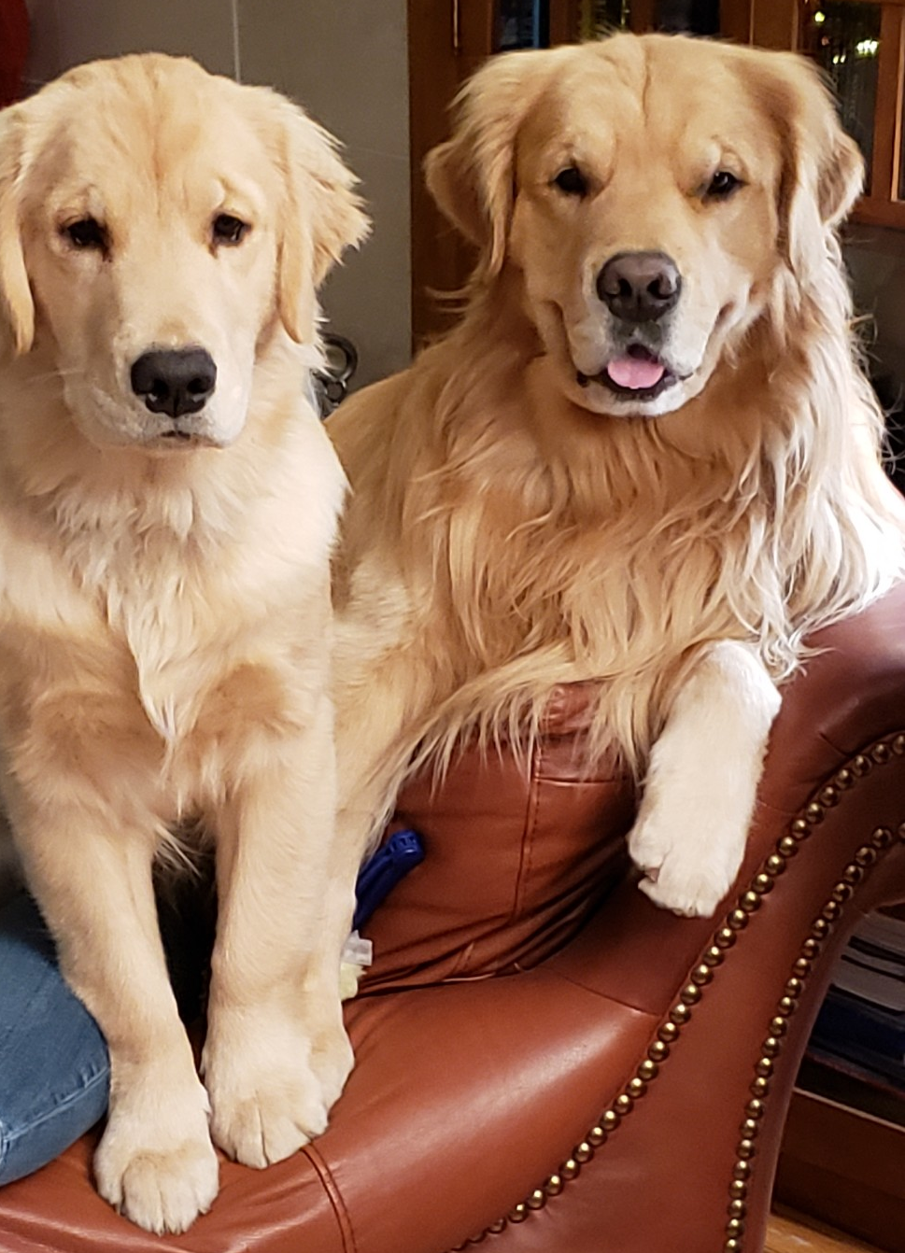
Thank you
.

