Slide 1
ARCOS ACGME Update
S. Elizabeth Ames, MD elizabeth.ames@med.uvm.edu
New RRC leadership.
New executive director.
Undying thanks to Corey Parker, Jennifer Luna, Citlali Meza

Slide 2
RRC 101
There is a big difference between accreditation and certification:
Our world – do we prepare competent general orthopaedic surgeons prepared for fellowship training and ready to pass ABOS step 1?
ABOS world – monitoring early clinical performance both operatively and professioally.

Slide 3
RRC 101
Program design, management, and standards are the provence of accreditation:
Common program requirements: benchmark.
Specialty requirements: added to match the needs of the specialty:
Orthopaedic curricular standarrds.
Rotation specifics.
Curricular design.

Slide 4
What’s on your mind?
Ability to help faculty learn about face to face assessment:

Slide 5
FLOURISHING ORTHO COORDINATORS…….!
S. Elizabeth Ames, MD​

Slide 6
Wrestling wellness?!?!?!
How can we be intentional in our population (GME) when the environment is:
So fundamental to our lives and important to our mental health.
Well beyond our control in many ways.
Full of lots of players (biggest football team ever………….)
Wicked problems need deep solutions.

Slide 7
THE ORTHOPAEDIC COMMUNITY
ACGME
RESEARCH TEAM
ADMIN
FACULTY
RESIDENTS
Stuart Slavin
Tim Brigham
Nick Yagmour
Ames
Ponce
Pearsons
Templeton
PD and Program Coordinators

Slide 8
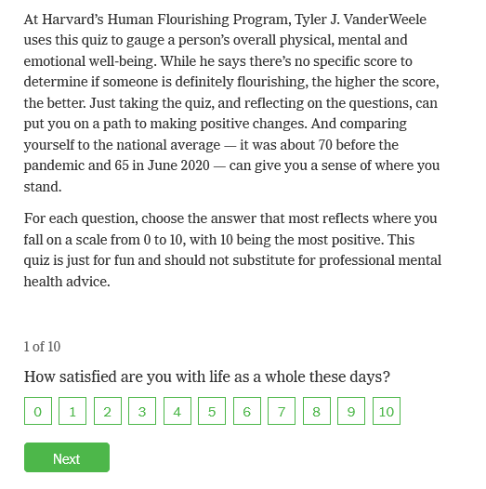
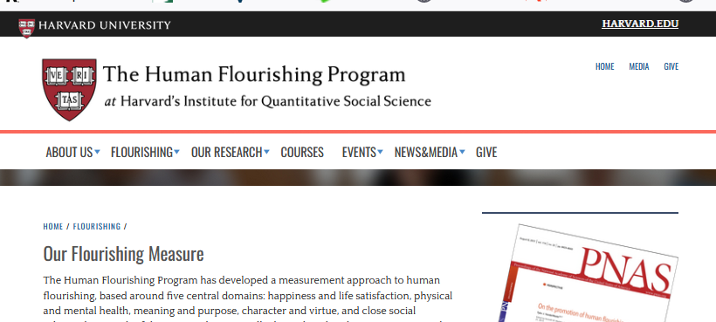
THE FLOURISHING MEASURE
TJ VanderWeele, 2017

Slide 9
Stuart Slavin CREDIT!
What drives wellbeing? Leaders.
If they are not well, those they serve will not be well.
There is a gap in wellbeing for program coordinators and program directors in GME.
Can we shift to an approach that can do something…. Provide an outlet?

Slide 10
Where we are…..
You participated in ACGME Coordinators Survey (all specialties) headed up by Dr. Slavin.
We approached the Flourishing Index Crew and solicited their help.
Drs. Brigham and Slavin have been interested from the beginning (consultant role for data analysis etc).
The next step is to pick an approach within the orthopaedic team!

