Slide 1
GRATITUDE & RESPECT TO ARCOS
L. Scott Levin, MD FACS
Chief Medical Officer, AOC Connect
Vice President and Associate Dean for Resource Development
Paul B. Magnuson Professor & Chairman
Department of Orthopaedics, Professor of Surgery (Plastic Surgery)
University of Pennsylvania School of Medicine

Slide 2
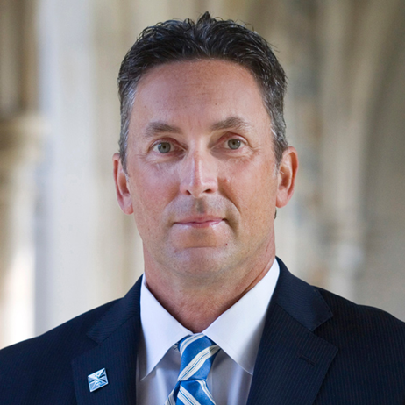
MICHAEL GAGNON MBA

Slide 3
THE IMPORTANCE OF RESIDENT & FELLOWSHIP PROGRAM COORDINATORS
THANK YOU TO KIM REISING for the opportunity to be here
YOU all are CRITICALLY IMPORTANT to the academic orthopaedic landscape.
Your IMPACT as Resident and Fellowship Coordinators expertly oversee our training programs and position us all for success
CONGRATULATIONS to Cynthia and Jennifer for their leadership awards!

Slide 4
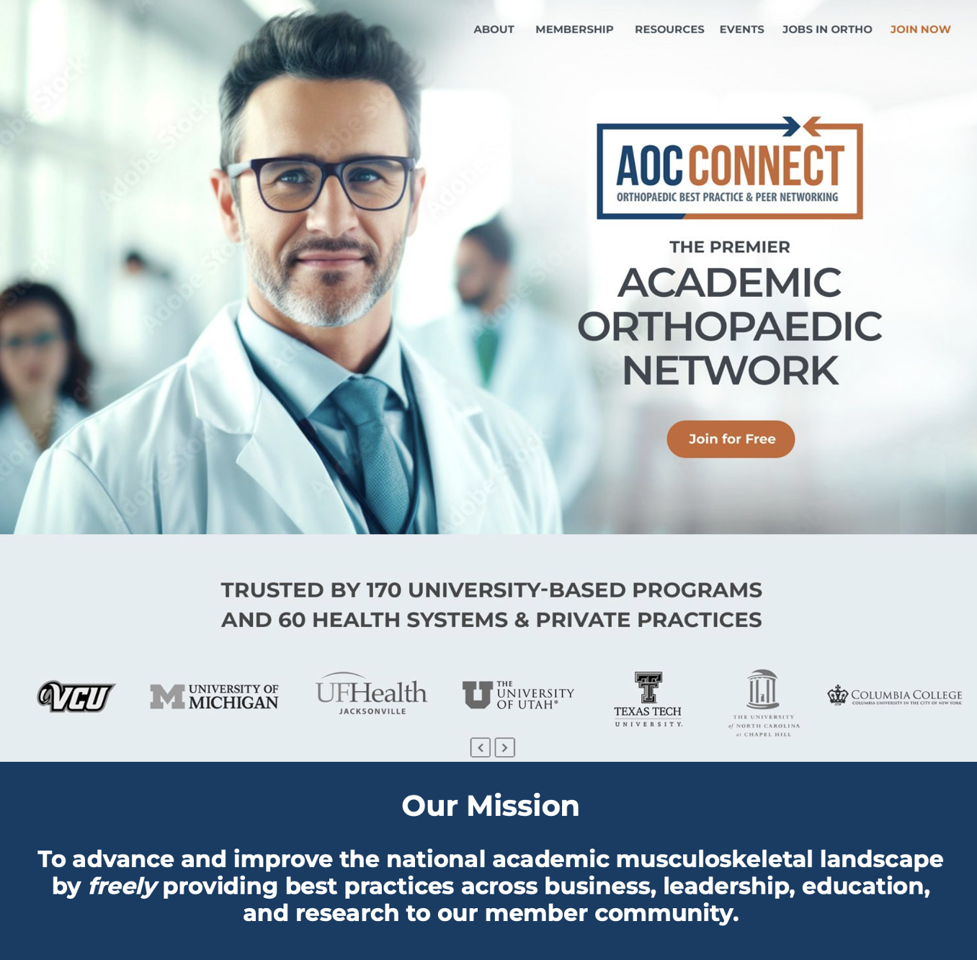
ABOUT THE AOC
Established 2005
Chairs, Vice Chairs, Faculty, Administrators, Residents & Fellows, Program Coordinators
Best Practices -Academic Missions
Top Rated Academic Orthopaedic Organization
#1 Orthopaedic Job site (JobsInOrtho)
5,400 members
170 Universities
60 Health Systems/Private Practices

Slide 5
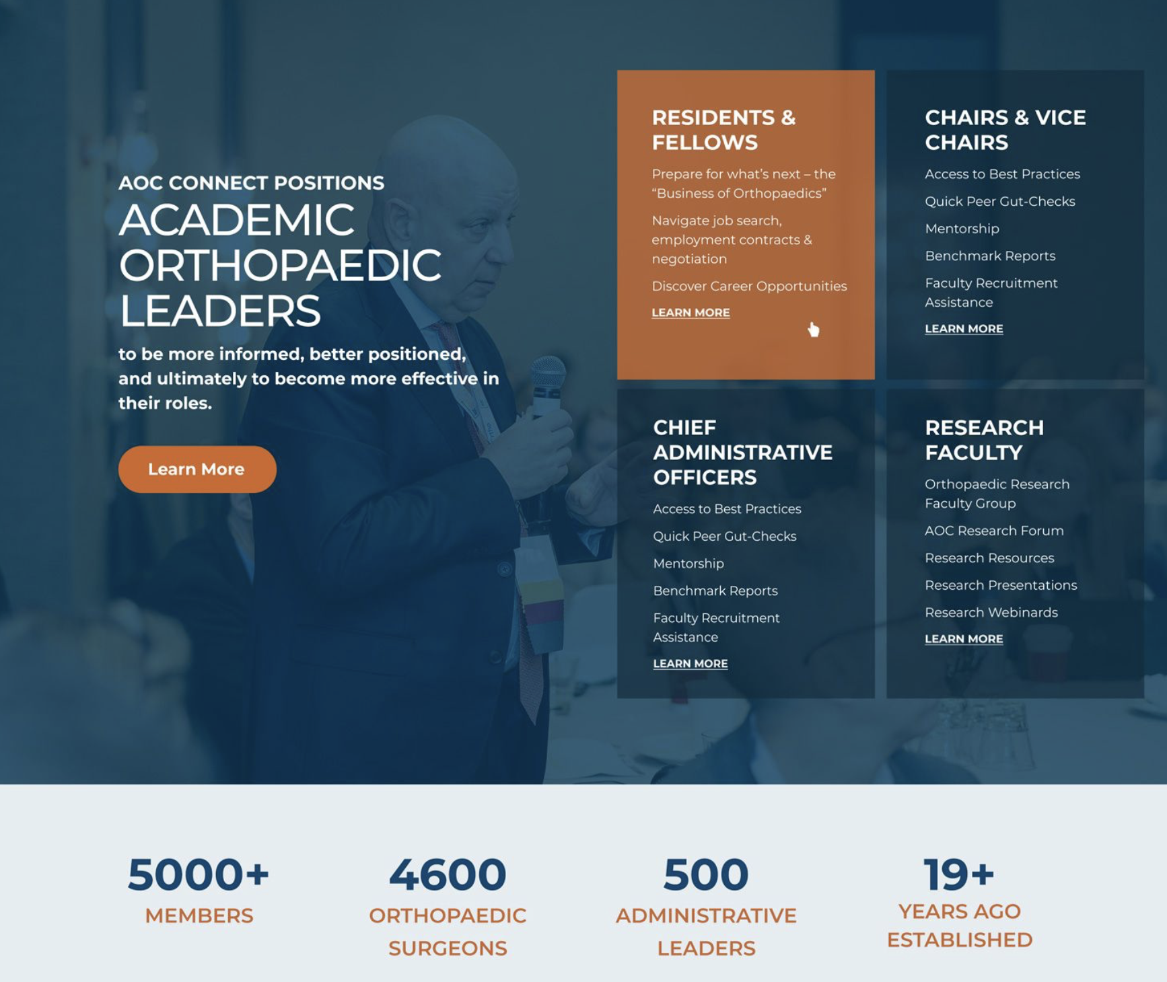
80% OF OUR CHAIRS requested AOC’s free resources to help prepare their Residents & Fellows for “what’s next”
The Business of Orthopaedics
How to Navigate Job Search, Employment Contracts, and Negotiation
RESIDENTS & FELLOWS prioritized the content we developed and also gave input on creation of JobsInOrtho

Slide 6
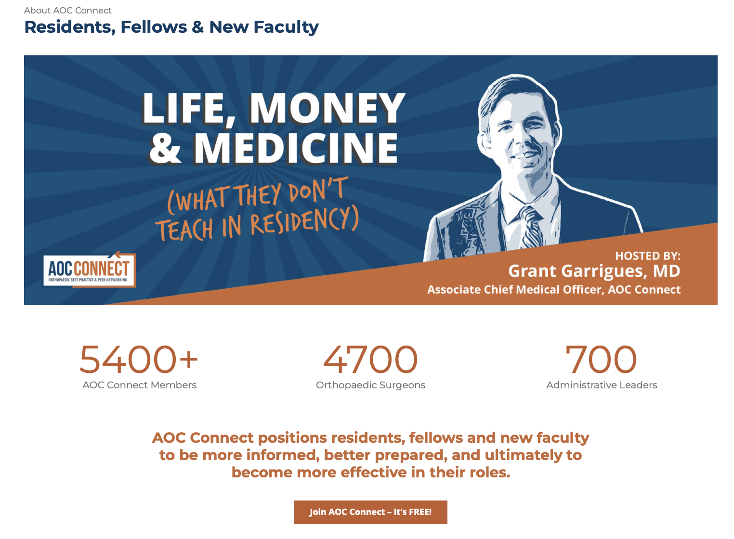
About the AOC
All of this incredible content is free and located on our digital platform in one easy location.
Click the link below:
https://myaocconnect.com/residents-fellows-new-faculty/

Slide 7
Thank you, ARCOS!

