Slide 1
American Board of Orthopaedic Surgery Report to ARCOS: Graduate Medical Education Initiatives
David F. Martin, MD, Executive Director Sonya Parker, Certification Specialist and Part I Exam Specialist Mona Saniei, Graduate and Professional Education Specialist

Slide 2
ABOS Mission Statement
To ensure safe, ethical, and effective practice of orthopaedic surgery, the ABOS maintains the highest standards for education, practice, and conduct through examination, certification, and maintenance of certification for the benefit of the public.

Slide 3
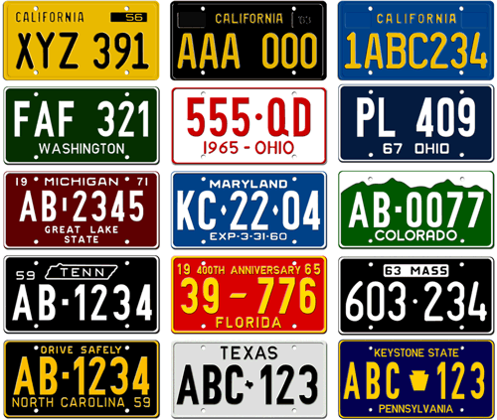
Licensure vs. Accreditation vs. Certification
Licensure
Process by which an individual physician is given permission to practice medicine within a particular state.
Accreditation
Process for determining whether a training (educational) program conforms to established educational standards.
Certification
Process by which a medical specialty Board grants recognition to an individual physician.

Slide 4
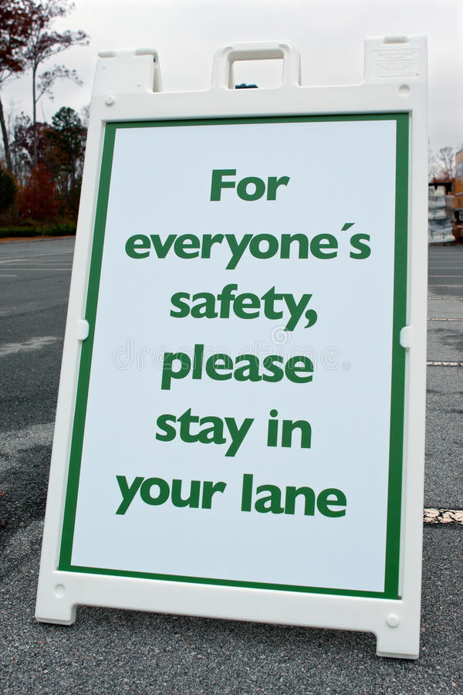
Orthopaedic
Organizational
History
American Medical Association
1847
American Orthopaedic Association 1887
1933
1934
American Academy
of
Orthopaedic Surgeons
American Board
of
Orthopaedic Surgery
GME
Orthopaedic Leadership
LCME,
Orthopaedic
RRC
1972
CME
Advocacy
ACGME,
Orthopaedic
RRC
1981
Board
Certification
Accreditation

Slide 5
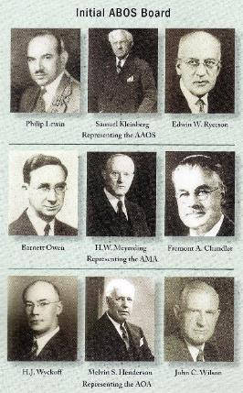
ABOS
Founded in 1934
AAOS, AOA, AMA
Private, voluntary, non-profit, autonomous organization
Exists to serve the best interests of the public and the medical profession
Establishes educational standards for orthopaedic residents
Evaluates the initial and continuing qualifications and competence of practicing orthopaedic surgeons

Slide 6
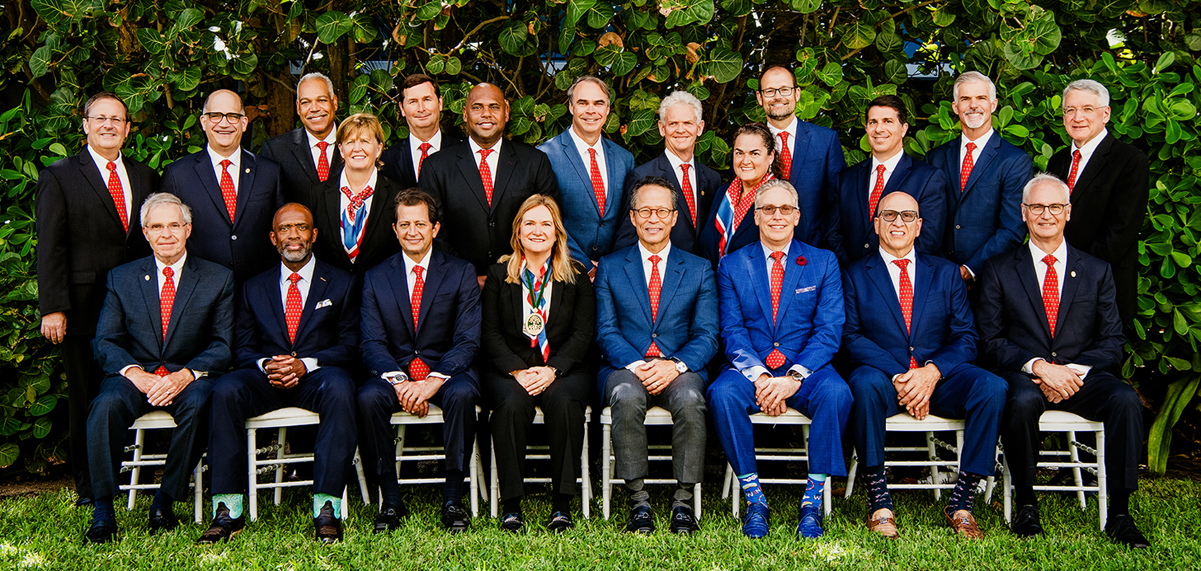
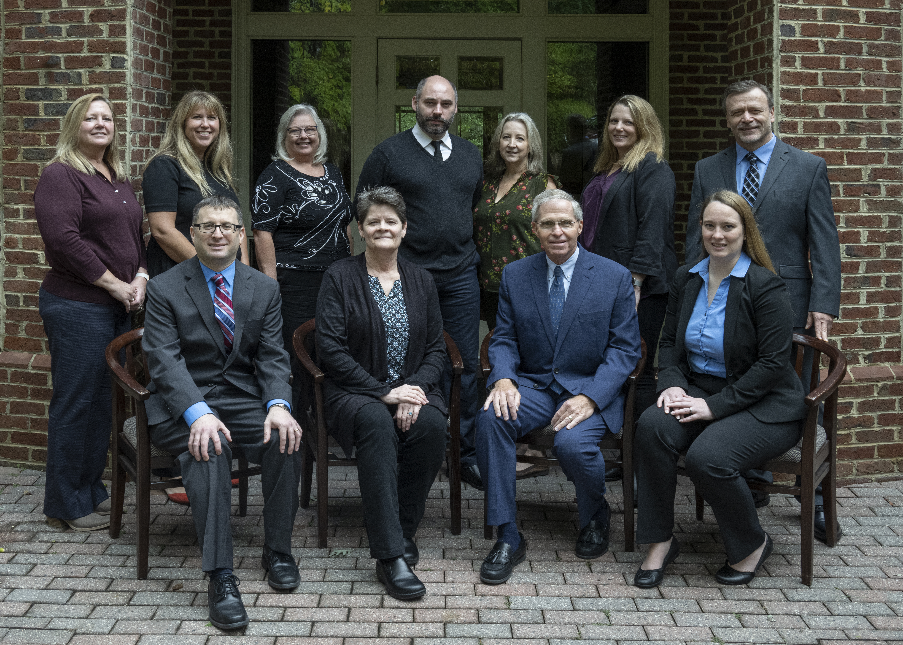
ABOS Composition – Who is the ABOS today?
Board of Directors
21 Member Board (National/Voluntary)
20 Orthopaedic Surgeons
10-year term (two new Directors each year)
1 Public Member
6-year term
Full Time Staff - Chapel Hill
14 Staff Members
Executive Director/Associate Executive Director
Examination/Credentialing/Communications/IT
Advisors: Legal, IT, Web, Psychometrics
AMERICAN BOARD OF ORTHOPAEDIC SURGERY
Fall Meeting
2023
AMERICAN BOARD OF ORTHOPAEDIC SURGERY
Full time Staff
2022

Slide 7
ABOS Part I Examination
‘The Written Examination’
General Orthopaedics / Basic Science / Problem Solving
Diagnosis and treatment of patients
328 multiple choice questions
8 hours of testing time over a 9-hour day – Pearson Vue Testing Centers
40 minutes of break time
20 minutes of tutorial time
Extra time is available
Notes:
7

Slide 8
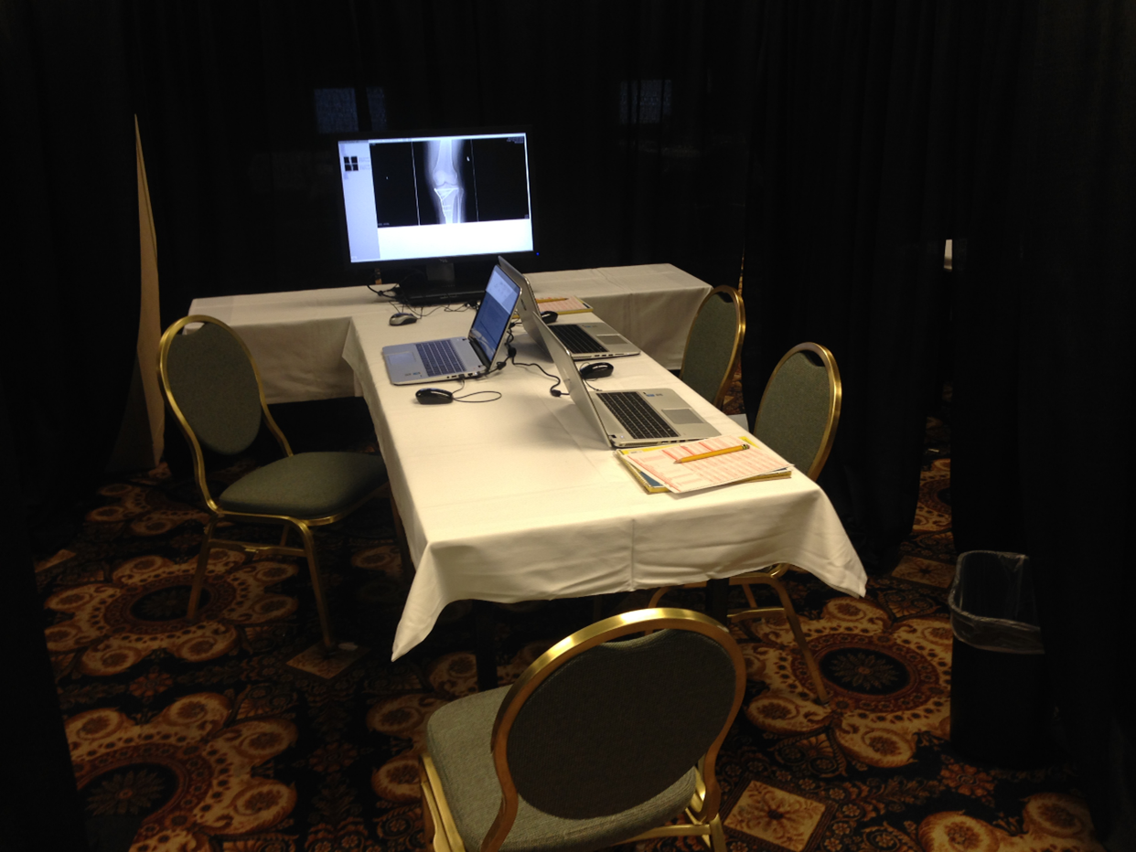
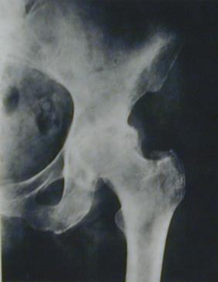
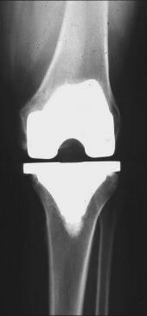
ABOS Part II Oral Examination
The Oral Examination
Judgment / Knowledge / Decision Making
Not easily assessed by a written examination
Practice-based examination
ABOS: ‘Best Test’

Slide 9
Residency Programs and ABOS
Highest Standards for Graduate Medical Education
ABOS Rules and Procedures for Part I
ABOS RRA
Competency-Based Assessment
ABOS KSB Program
PGY-1 Surgical Skills/6 months of Orthopaedic Rotations

Slide 10
Topics
ABOS Knowledge, Skills, and Behavior (ABOS KSB)
ABOS Record of Resident Assignment (RRA)
ABOS Residency Activities Portal - To-Do List!
ABOS Resident Opportunities
Information & Resources

Slide 11
ABOS KSB
Why are we doing it?

Slide 12
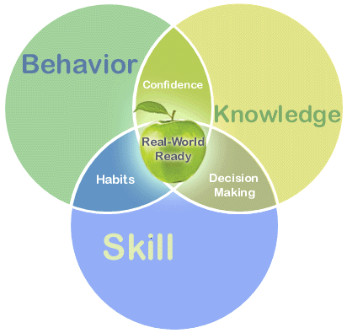
ABOS Knowledge, Skills, and Behavior Program
Surgical Education Shift
Time-Based Competency-Based
Goal: Time + Competency
Deficiencies exists in:
Documentation
Measurement
Teaching
ABOS Goal: provide assessment tools for the measurement of:
Knowledge, Surgical Skills, and Professional Behavior
Competence
Notes:
Has the resident attained the level of competence necessary for the independent practice of orthopaedic surgery and is the resident recommended for the certifying process of the ABOS:
Five years of accredited post-doctoral residency education are required. 2. One year must be served in an accredited graduate medical education program whose curriculum fulfills the content requirements for the PGY-1 (see Section IV.B.l) and is determined or approved by the director of an accredited orthopaedic surgery residency program. An additional four years must be served in an accredited orthopaedic surgery residency program whose curriculum is determined by the director of the accredited orthopaedic surgery residency. 3. Each program may provide individual leave and vacation times for the resident in accordance with overall institutional policy. However, one year of credit must include no more than 50 weeks of full-time graduate medical education per year; and at least 46 weeks of full time graduate medical education per year; averaged over five years. Graduation prior to 60 months from initiation of training is not allowed. 4. Program Directors may retain a resident for as long as needed beyond the minimum required time to ensure the necessary degree of competence in orthopaedic surgery. According to the current Special Requirements of the RC for Orthopaedic Surgery, the committee must be notified of such retention. This information must also be provided to the ABOS through the Record of Residency Assignment program.

Slide 13
ABOS KSB Program in Residency
Knowledge
Rarely an issue
Smartest individuals
Best test-takers
But if you don’t pass Part I the first time…
Skills
Sometimes an issue in early practice
Try to achieve greater independence before graduation
Identify early if a resident does not have high technical skill
Behavior
Sometimes an issue early in practice
Sometimes an issue later in practice
Can behavior improve during residency?

Slide 14
MYTH VS. FACT
MYTH
FACT
Data will be used for hiring or credentialing
ABOS will not share this data
Data will follow to Fellowship
Data is not validated nor intended for Fellowship apps or recruitment
Program Director has ultimate discretion
Participation will be a requirement to sit for ABOS Part I

Slide 15
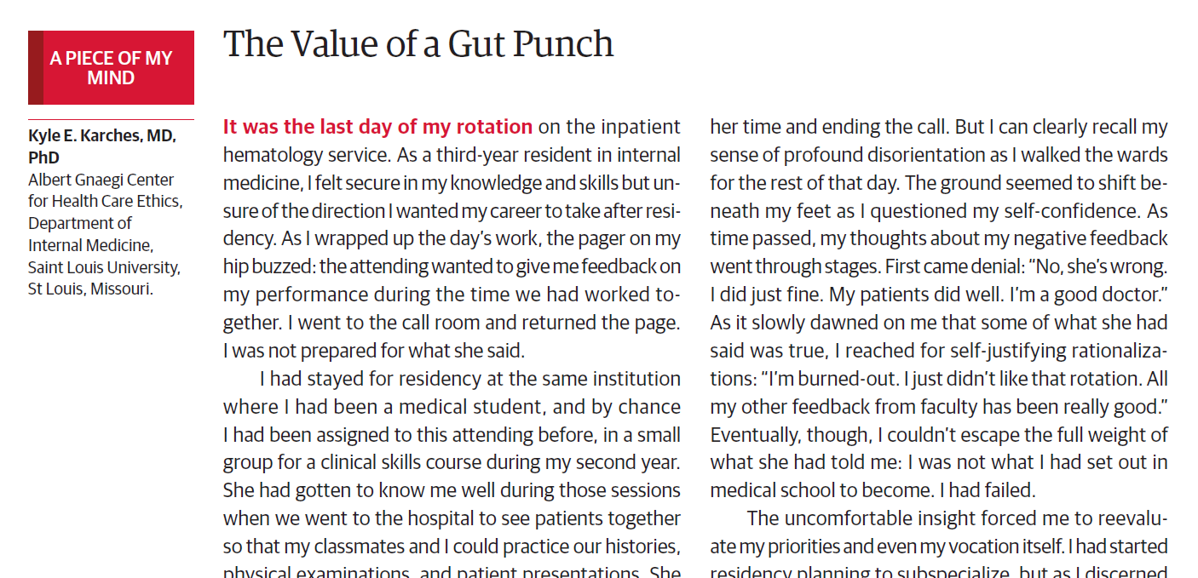
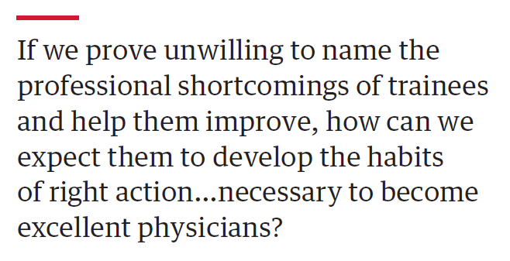
“If you’re an average player, you want to be left alone because you want to be able slide by. If you’re a good player, you want to be coached. If you’re a great player, you want the coach to tell you the truth every day.”
-Nick Saban, Head Football Coach, University of Alabama
JAMA November 8, 2022 Volume 328, Number 18 1809-1810

Slide 16
ABOS KSB
How does it work?

Slide 17
ABOS Goal: provide assessment tools for the measurement of:
Knowledge, Surgical Skills, and Professional Behavior

Slide 18
ABOS KSB Requirement
Beginning academic year 2025/26: July 1, 2025
Participation is required, not specific levels of achievement

Slide 19
How It Works-Surgical Skills
Completed Surgical Skills assessments are sent back to the resident in real-time.

Slide 20
What Residents Need to Do
Surgical Skills
PGY-2 – PGY-5: 2 Surgical Skills Assessments per week or 8 a month
PGY-1 residents-Small requirement likely
Residents have 48 hours from procedure date to request assessment
Faculty have 72 hours from assessment request to respond
Notes:
Williams et al., Williams RG, Chen XP, Sanfey H, et al. The measured effect of delay in
completing operative performance ratings on clarity and detail of ratings
assigned. J Surg Educ. 2014;71:e132–e138.
Williams et al11 found that clarity and detail of ratings provided
were affected by the delay in completing operative performance ratings.
Ratings completed more than 14 days after observing the performance
had no item-to-item variation, suggesting the rating conveyed a global
impression of the performance. Comments, rarely offered, were most
oftenexclusively global comments like ‘‘goodjob.’’Suchcomments are
not actionable and are of little value to the performing surgeon for
improving subsequent performances. Ratings completed immediately
after observing performances almost always exhibited item-to-item
variation. Ratings completed within 72 hours generally included item
to-
item variation, contained written comments, and the written com
ments
were specific and actionable (Class II data—large number of
participants but study should be replicated using randomized controlled
design to control nonindependence of judgments).

Slide 21
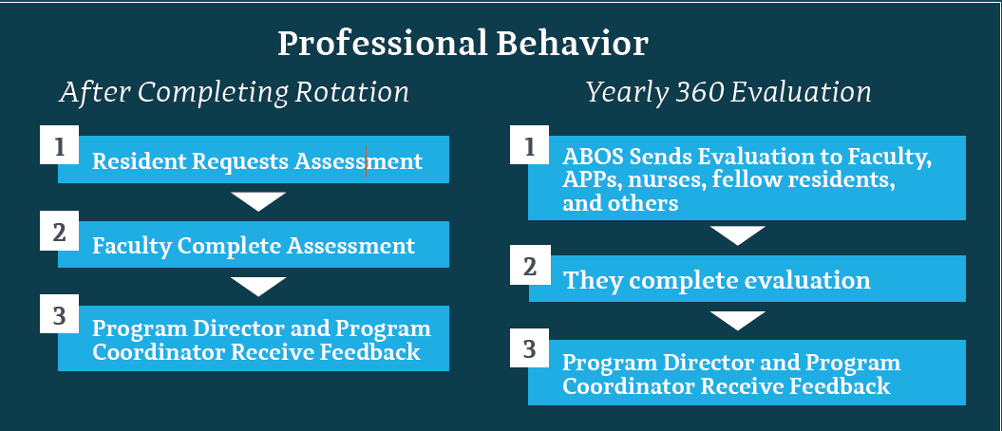
How it Works-Professional Behavior
Professional Behavior feedback goes directly to Program Director/Program Coordinator and/or APD.

Slide 22
What Residents Need to Do
Professional Behavior
PGY 1-5 Request End-of-Rotation Professional Behavior Assessments
Goal of 6 a year
PGY-1- Smaller Requirement

Slide 23
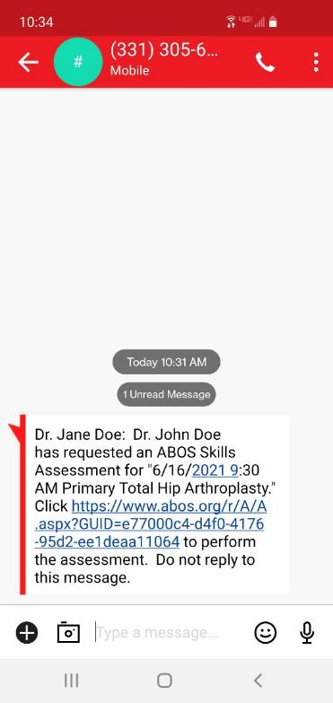
Faculty Interface
Smartphone-Optimized
The evaluator receives a text/email with a link
Dictate the open-ended feedback
Reminders: 24-hours

Slide 24
Surgical Skills Assessment
Notes:
All questions available online on our website if faculty want to review ahead of time.

Slide 25
Professional Behavior Assessment

Slide 26
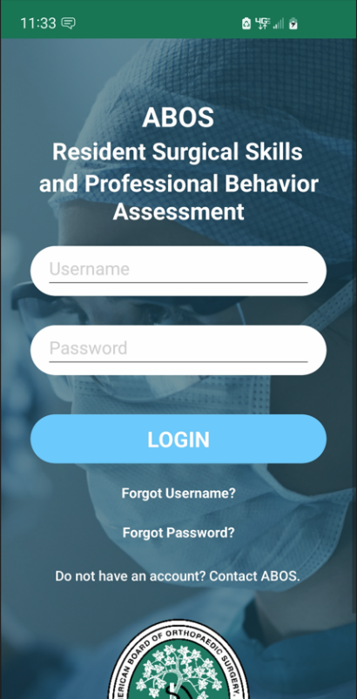
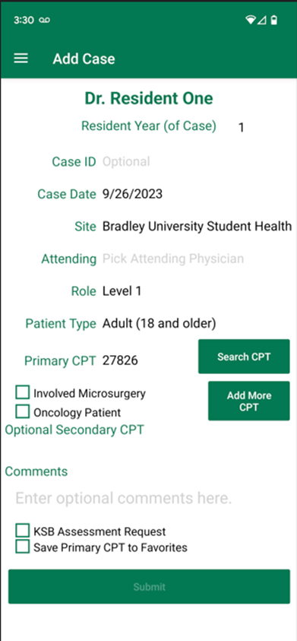
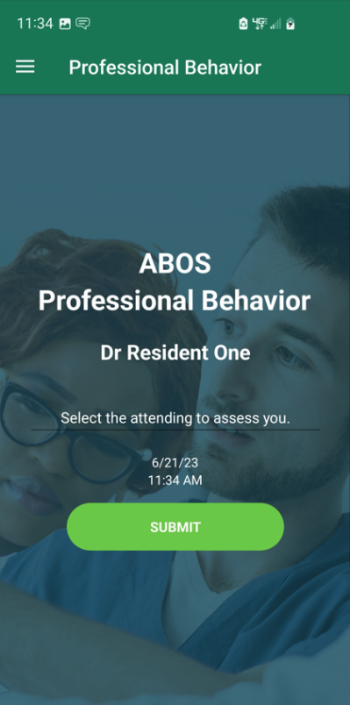
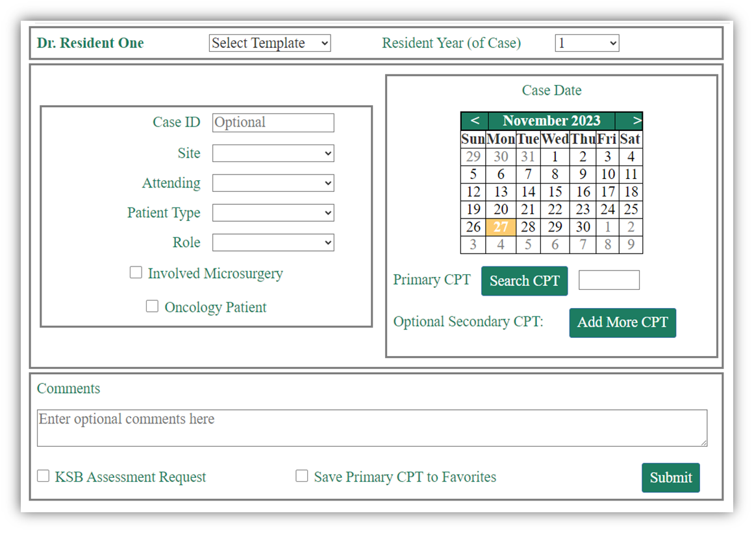
ABOS KSB+ Integrated Platform App & Web Portal

Slide 27
ABOS KSB+ FAQs
Is ABOS KSB Program replacing ACGME Case Logs?
No, this is a collaboration.
Should residents enter all their ACGME Case Logs through the ABOS KSB Program?
Yes
Are all residency programs required to participate?
Yes, if there are residents that wish to be ABOS Examination Candidates.
How do Program Directors and Program Coordinators review ACGME Case Log Data?
Continue to use ACGME ADS Case Log System.
Can a resident claim credit for more than one procedure done on a single patient on a single date via the ABOS KSB Platform?
Yes, in an identical fashion as was done in the ACGME ADS system. Residents must enter cases such as those that have two or more separate entries in the integrated platform.
Who owns the data?
The data are owned by the ABOS. The ACGME Case Log data are owned by the ACGME.
Do residents have to log a case within 48 hours?
If they want to request the corresponding ABOS KSB Surgical Skills assessment.

Slide 28
ABOS KSB+ Platform Availability
Group # | Program to Receive Access to ABOS KSB+ Platform | Deadline to Switch Over from ADS
1 | Complete | Complete
2 | Complete | 12/2023
3 | 3/2024 | 4/30/2024
4 | 5/2024 | 6/30/2024
5 | 7/2024 | 8/30/2024
6 | 9/2024 | 10/30/2024
7 | 11/2024 | 12/30/2024
8 | 1/2025 | 2/28/2025
8 Onboarding Groups
Groups 1-4 based on prior use of ABOS KSB
Groups 5-8 randomly selected

Slide 29
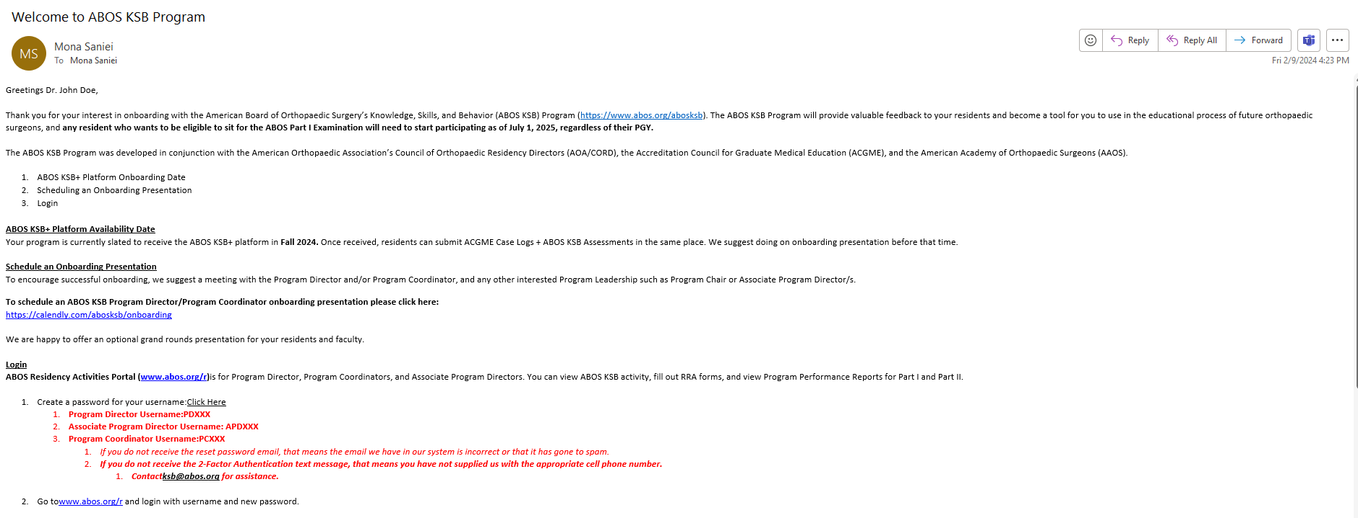
ABOS KSB Onboarding Email -February

Slide 30
ABOS KSB Onboarding Emails
Week of 3/19/2024
ABOS KSB+ Platform
ABOS KSB Platform Availability Date
Prior to Jan 1, 2025
Schedule an onboarding presentation
Login Information for PD/PC/APDs
Email ~2 weeks prior to availability
Once date arrives: all Residents will receive instructions on how to download from Android and Apple and how to use

Slide 31
ABOS RRA
What is it and how does it work?

Slide 32
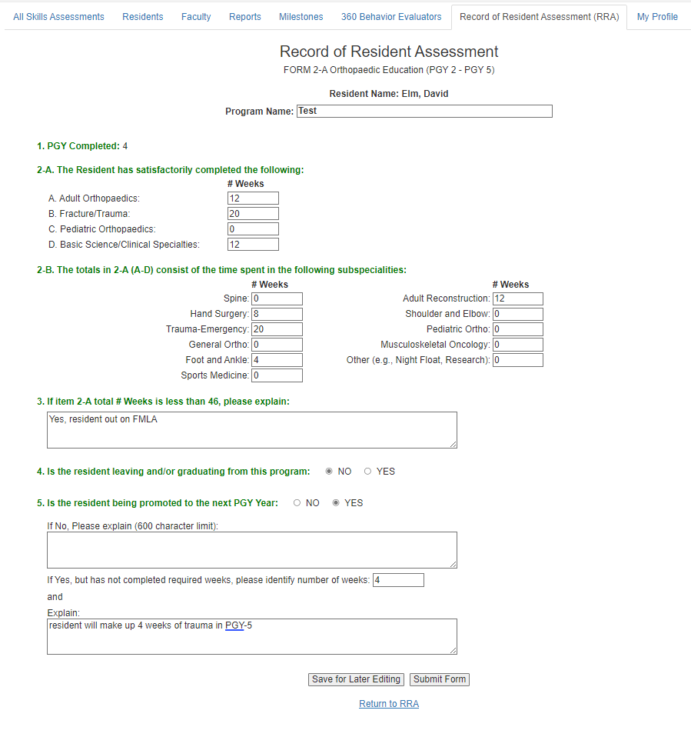
Record of Resident Assignment Forms (RRA)
Yearly Forms must be submitted between May 15th and June 15th. Program Directors have until June 30th to sign off.
Record weeks of experience per year
If deficit, forms will keep track
May 15-June 15
You are documenting their current year

Slide 33
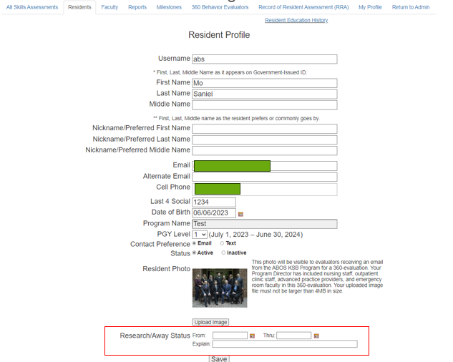
New Features
Research/Away Status
Red Flags

Slide 34
Unusual Situations
Extended Leave/Away Time
Program Director must send a letter
Remediation Plan
Late Cycle Residents and Late Graduates
2 Letters
Introducing Resident
First Line Verification from previous programs
Prematurely Leaving Resident
Fill out RRA Forms + Form 3
PD Sign Off
Resident will be automatically marked inactive

Slide 35
RRA Program Coordinator Steps:
Login to www.abos.org/r
Confirm your Resident List is correct
Fill out form/s for each resident
PGY Dependent
Contact your PD to Sign Off
PD Form 1a/2a Total Report
PD Signs off on each individual Form 3 for every leaving/graduating resident.
Your PD cannot sign off until you have completed all forms.

Slide 36
ABOS Residency Activities Portal
Coordinator To-Dos!

Slide 37
ABOS Program Coordinator Quick Guide
ABOS Residency Activities Portal: www.abos.org/r
Maintain Resident List
1
Enter incoming residents yearly
Maintain Faculty List
2
Pull ABOS Reports
3
ABOS KSB Reports
ABOS Program Performance (Graduated Resident Part I/Part II Results)
Insert ABOS KSB 360 Behavior Evaluators
4
Fill out RRA Forms and Resident Education History
5
Keep your My Profile Tab Up to Date
6

Slide 38
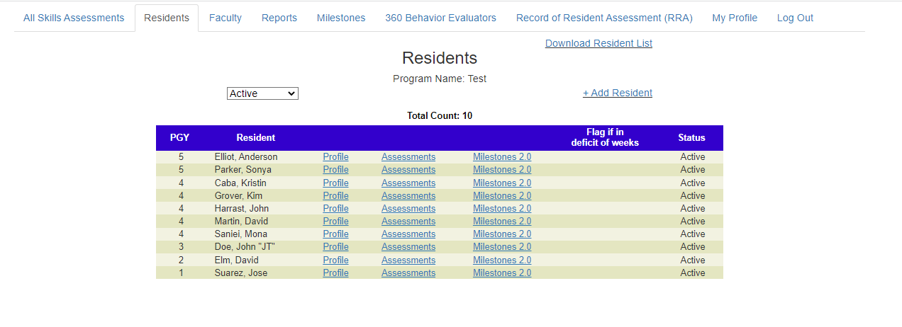
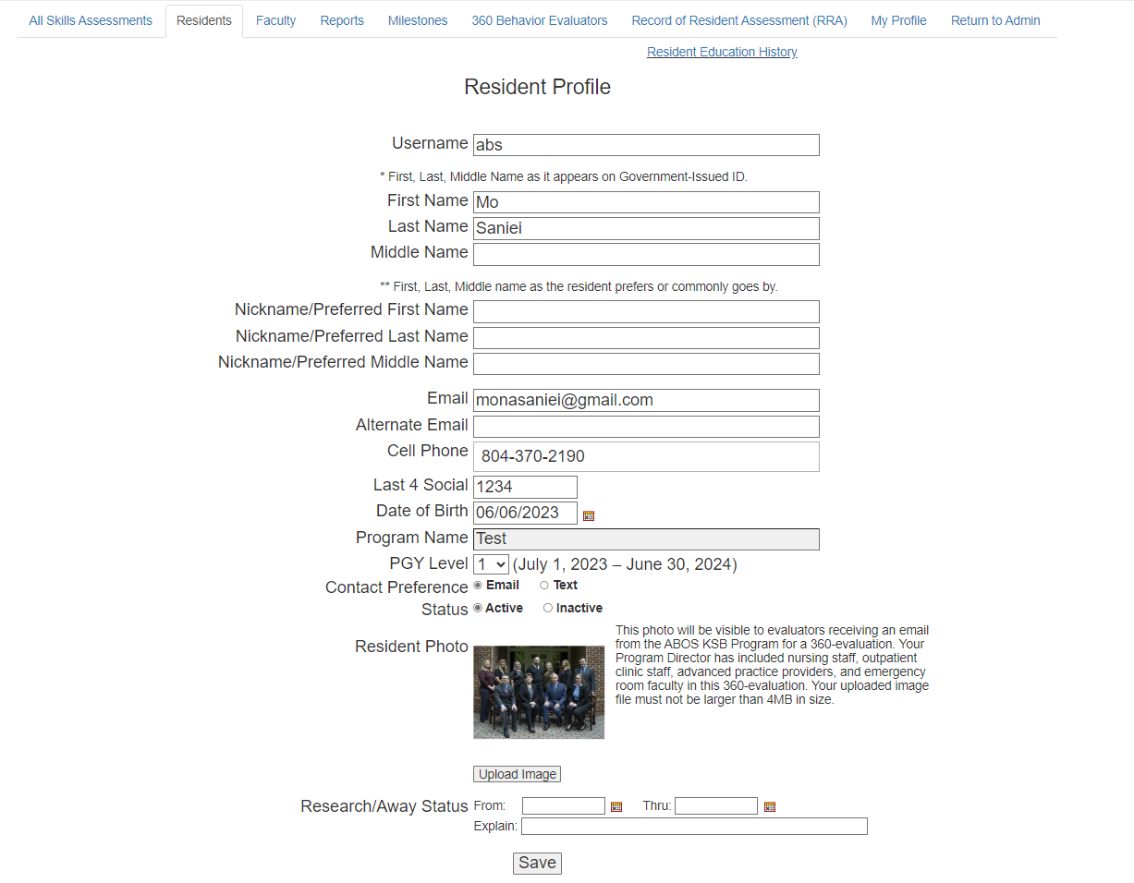
Maintain Resident List
Enter incoming Residents as PGY-0s by June 30
Maintain List throughout year
1

Slide 39
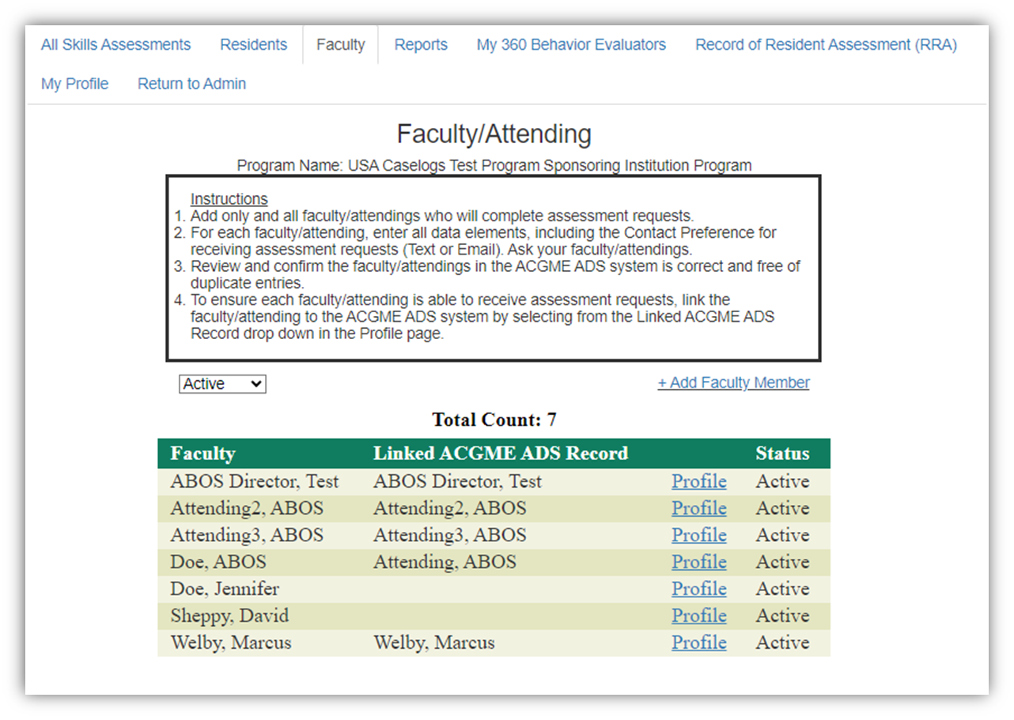
Maintain Faculty List
How to Use the ABOS Faculty Tab:
Put only faculty you want to use as ABOS KSB Evaluators
Contact Preference
Review and confirm list of faculty/attendings on ADS
Match name with ACGME ADS
2

Slide 40
Pull ABOS Reports
Please explore these reports and what they have to offer
Many of them are downloadable (Excel or PDFs)
If you have any questions, please contact ksb@abos.org
3

Slide 41
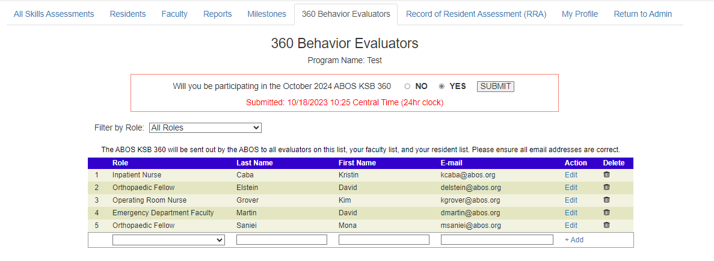
ABOS KSB 360
Yearly Professional Behavior Assessment
Facilitating the ABOS KSB 360 is part of the ABOS KSB requirement.
October
Residents, Faculty, and all others 360 evaluators
Enter 360 Evaluators in 360 Behavior Tab by September 15th
4

Slide 42
Record of Resident Assignment Forms (RRA)
Yearly Forms must be submitted between May 15th and June 15th. Program Directors have until June 30th to sign off.
Yearly documentation provided by residency program to ABOS
Weeks on Rotation
Residents will need to have met minimums laid out via the ABOS Part I Rules and Procedures
5

Slide 43
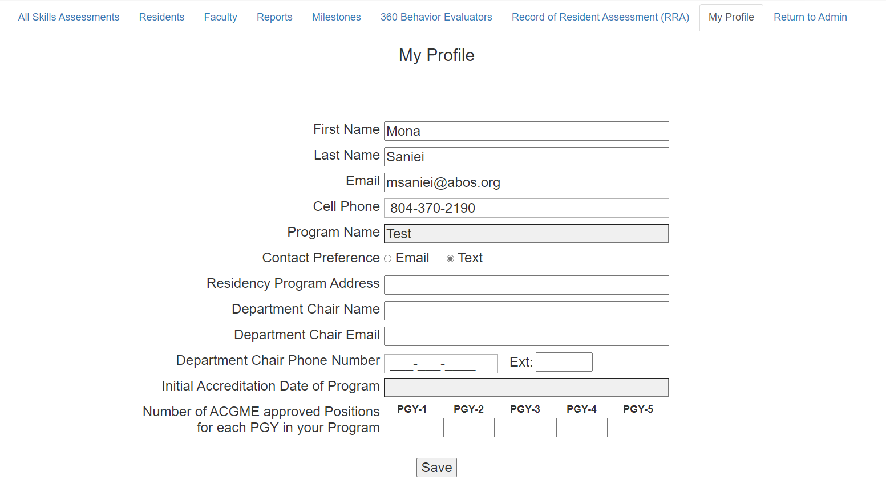
Profile
Keep it up to date
My Profile Tab helps us communicate with you
The ABOS does not send blanket emails
If there is a personnel change, please contact us
6

Slide 44
Resident Opportunities

Slide 45
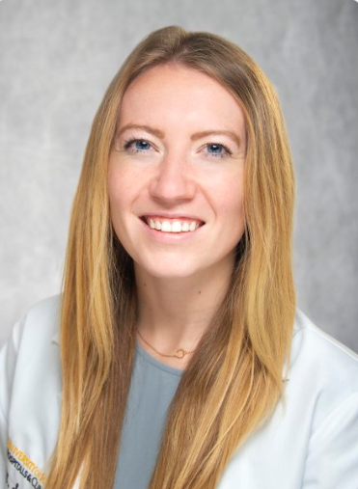
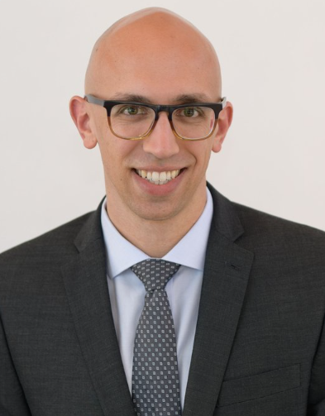
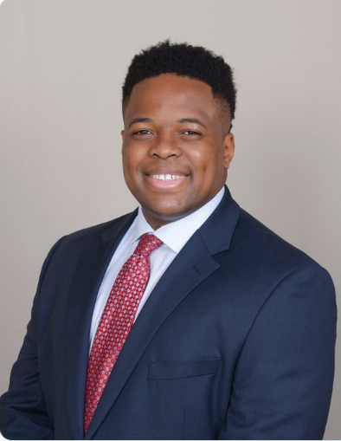
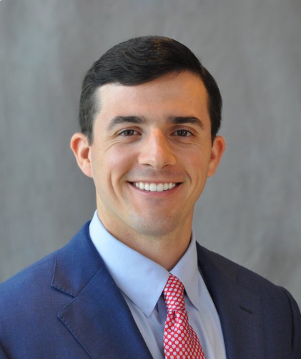
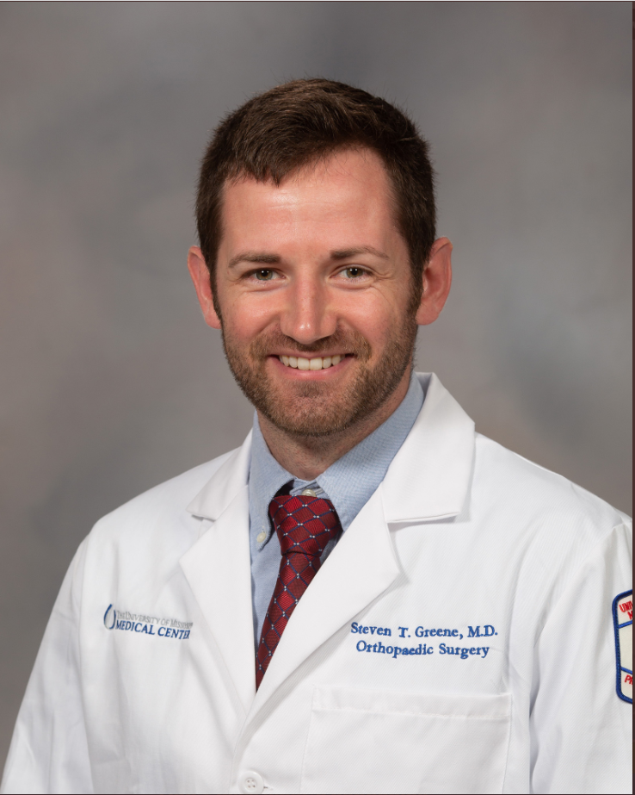
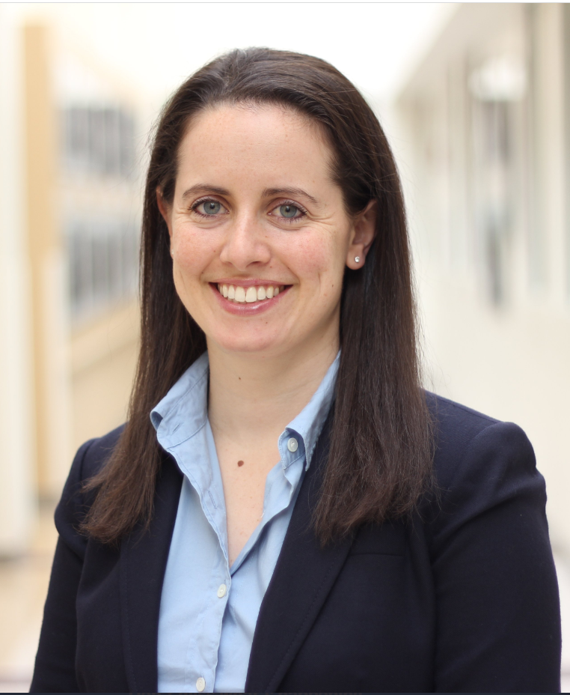
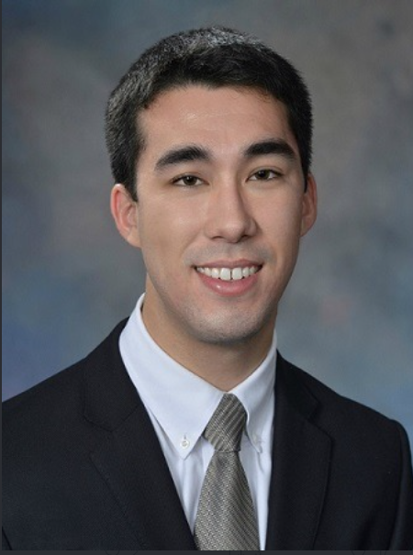
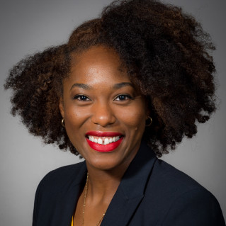
Current ABOS Resident Advisory Panel (RAP)
Dr. Mary Kate Skalitzky
University of Iowa
Dr. Christopher Johnson University of Chicago
Dr. Justice Achonu
Stonybrook University
Dr. Clay Townsend
Temple University
Dr. Steven Greene
University of Mississippi
Dr. Michelle Lawson
Oregon Health & Sciences University
Dr. Joseph Sliepka
University of Washington
Dr. Claire Isabelle Verret
Zucker at Hofstra/Northwell

Slide 46
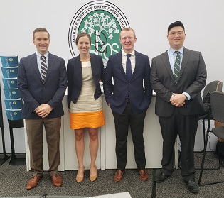
What is involved?
Quarterly virtual meetings with GME to learn about MOC
Work on a project proposal over their two-year terms
Act as resident champions for resident related initiatives
Attend conferences, various symposia, and summits
Notes:
Mention resident advisory panel project?

Slide 47
ABMS/ABOS Visiting Scholar Program
One Year
Part-time program facilitating research projects related to Board Certification and Maintenance of Certification.
Exposure to:
Professional Assessment
Education
Health Policy
Quality Improvement
Application available in March with a deadline of June 2024
Apply through ABMS

Slide 48
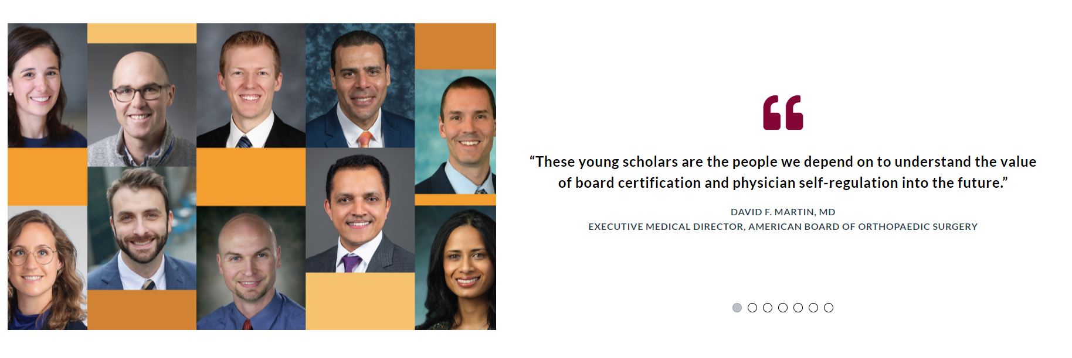

Slide 49
Information & Resources

Slide 50
Deadlines
Part I Application
Opens August 1, 2024
Deadline: October 1, 2024
ABOS Record of Resident Assignment (RRA)
May 15-June 15 (Deadline)
Program Coordinators must enter yearly forms
June 30th (Deadline)
Program Director Sign Offs on Forms
ABOS KSB
Requirement Starts July 1, 2025

Slide 51
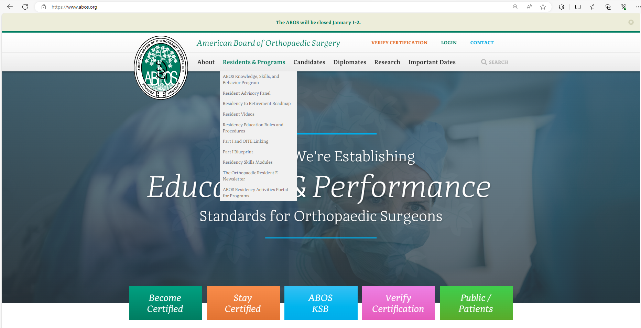
WWW.ABOS.ORG
Use the Resident and Program Menu option to learn more about all things related to residency including:
ABOS KSB
Part I/OITE Linking Project
ABOS Residency Activities Portal

Slide 52
ABOS Residency to Retirement Roadmap
ABOSRoadMap.org
Discover process residents must take from residency all the way to retirement

Slide 53
Webinar Series
Webinar Topic | Month
Who is the ABOS? | April 2024
ABOS RRA Forms | May 2024
ABOS KSB Program Requirement-Program vs Resident | June 2024
ABOS KSB+ (Ins and Outs of the ABOS KSB+ Tool) | July 2024
ABOS KSB 360 | August 2024
ABOS Part I Application Process | September 2024
ABOS Surgical Skills- PGY 1 Modules | October 2024
ABOS KSB Town Hall | November 2024
ABOS KSB+ Troubleshooting | December 2024
ABOS KSB Onboarding | January 2025
ABOS Resident Opportunities | February 2025
ABOS KSB Requirement | April 2025
ABOS KSB Troubleshooting | May 2025
Recordings will be made available

Slide 54
ABOS KSB Website (www.abos.org/abosksb)
ABOS KSB Website
Materials & Tools

Slide 55
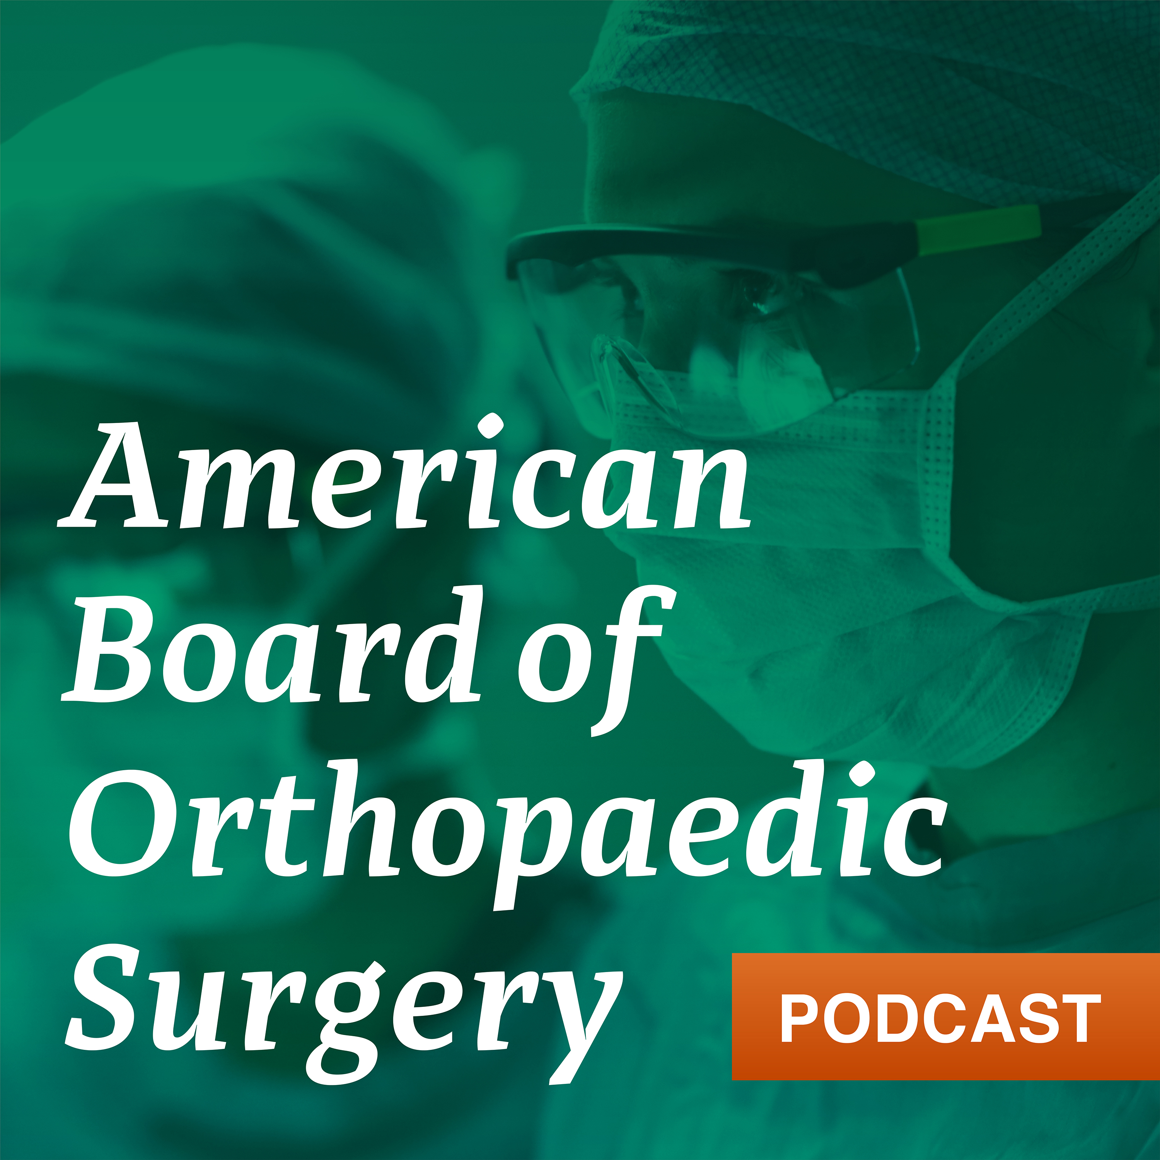
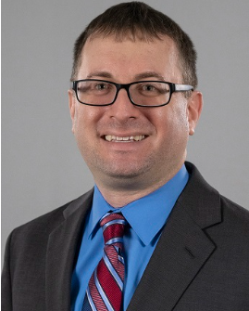
ABOS Podcast
anchor.fm/ABOS
Hosted By: David Elstein

Slide 56
Contact Information
Rotations, Rules and Procedures, Part I Application, and General RRA Inquires
ABOS KSB Program, Login, Technical Issues (RRA or KSB), ABOS Resident Dashboard, ABOS KSB+ Platform
Sonya Parker
Certification Specialist
American Board of Orthopaedic Surgery
sparker@abos.org (919) 929-7103
Mona Saniei
Graduate and Professional Education Specialist
American Board of Orthopaedic Surgery
msaniei@abos.org (919) 929-7103
Make a virtual helpdesk appointment: CLICK HERE

