Slide 1
ACGME Coordinator Advisory Group History and Accomplishments
September 2023
ARCOS 2024 Annual Meeting
Cindy Thompson, C-TAGME

Slide 2
Charge
To advise ACGME administration concerning coordinator, GME, learning environment, and accreditation matters
One source of insight in improving communications, ACGME process, and interactions with the GME community
Overall goal is to further ACGME Mission

Slide 3
Charge (cont’d)
Represent coordinators as a whole
Not representative of any specific organization, institution, or specialty
Diverse group by location, size of program/institution, specialty, and residency/fellowship

Slide 4
Composition and Terms
Meet twice per year
12 members
3 Hospital-based program coordinators
3 Medical program coordinators
3 Surgical program coordinators
3 Institutional coordinators
3-year terms

Slide 5
Coordinator Advisory Group Members: 2016-2019
Cordelia Baffic (PA)
Juanita Braxton (CA)
Sherry Bucholtz (WA)
Renda Chubb (OK)
Shannon Darrah (NH)
Amy Day (CA)
Maria DeOliveira (MA)
Melinda Feldkircher (OH)
Rhea Fortune (NC)
Michelle Kammerer-Jerome (NJ)
Katie Kellerman (KS)
Annette Lemire (AZ)
Janet Palmer (TX)

Slide 6
Coordinator Advisory Group Members: 2019-2023
Terry Bennett, BA, C-TAGME (VA)
Timothy Burns, BA, JD (VT)
Coranita Burt (OH)
Michelle Cichon, MS (MI)
Anne Hardie, C-TAGME (NY)
Laurie Hein, AAS, BA, MA (WI)
Megan Kinane Hosmer, MHA (OR)
Krista Lombardo-Klefos, MBA (OH)
Kandice McLeod, MEd, EdS, C-TAGME (TX)
Vicky Norton, BS, C-TAGME (MD)
Thea Stranger-Najjar, BA (IL)
Joseph Stuckelman, MFA, C-TAGME (KY)

Slide 7
Coordinator Advisory Group Members: 2023-2026
Julie Beckerdite, MBA (MA)
Reanna Benedict, MEd (NC)
Bethany Millar, BS, C-TAGME (MO)
Linda Ortiz Morrison, BA, CHCP, C-TAGME (MD)
Melanie Pigott, BA, C-TAGME (SC)
Carrie Racsumberger, MS (NY)
Angie Rangel (AZ)
Amanda Ross, BS, C-TAGME (CT)
Bret Stevens, EdD, MBA, C-TAGME (MI)
Cindy Thompson, C-TAGME (WV)
Ramona Tirado, MLS, C-TAGME (NY)
LaToya Wright, BBA, C-TAGME (TX)

Slide 8
Input and Advice
The CAG has provided input and advice to ACGME on a variety of topics and initiatives, including:
Resident/program concern and complaint process
Learn @ ACGME (distance education platform)
Accreditation Data System (ADS) – Annual Update
Changes and concerns related to the new Common Program Requirements
Data collection and reporting during the COVID-19 pandemic
Coordinator Forum Pre-conference
Recommendations for plenary presenters and topics
Review/judging process for Forum proposals

Slide 9
Input and Advice (cont’d)
Formatting and submission of program applications
The Program Directors’ Guide to the Common Program Requirements
ACGME Communications
Website
E-Communication
Communications to the GME community during the COVID-19 pandemic
ACGME social media efforts
ACGME FAQs
Medically underserved areas/populations and graduate medical education

Slide 10
Input and Advice (cont’d)
Institutional Accreditation and Recognition
New Institutional Coordinator Workshop topics and format
FAQs for Sponsoring Institutions with nonstandard programs
FAQs for leaves of absence requirements
Program Requirements related to protected time for program directors, assistant/associate program directors, program coordinators, and core faculty members
Diversity, Equity, and Inclusion (DEI) Annual Update data and the role of coordinators in improving and promoting DEI
Virtual Site Visits and Self-Studies

Slide 11
Tools for the GME Community
Developed new coordinator timelines for residency, fellowship and institutional coordinators
Published on ACGME Website
Developing a Coordinator Handbook
Working with Distance Learning to develop an online course for coordinators

Slide 12
Coordinator Well-Being
CAG is now a member on the ACGME’s Task Force on Physician Well-Being
Provided advice towards survey questions in the Coordinator Well-Being Survey
Well-Being Research Survey Committee
2 current members will continue after their CAG term

Slide 13
Additional Accomplishments
Reviewed session proposals for the 2020 through 2024 Coordinator Forum Pre-Conferences
Participated in “Connecting with Coordinators” Zoom calls
CAG membership on the ACGME Board’s Awards Committee
Participated in a Dominant Norms Workshop

Slide 14
Sharing with the GME Community
Delivered at least 20 presentations on behalf of the CAG:
ACGME New Coordinator Conference
“Connecting with Coordinators” Zoom calls during COVID
Association for Hospital Medical Education
National Society Meetings
Home Institution Meetings

Slide 15
September 2023 Meeting
This was a joint meeting with the 2019-2023 and 2023-2026 Coordinator Advisory Group. The agenda included:
Received updates and provided input and advice on
Distance learning initiatives
2024 Coordinator Forum
Coordinator Wellbeing
Department of Communications
Department of Diversity, Equity, and Inclusion
Accreditation Data System
The Site Visit Process
Institutional Accreditation and Recognition
Discussed goals and potential projects for the 2023-2026 Coordinator Advisory Group

Slide 16
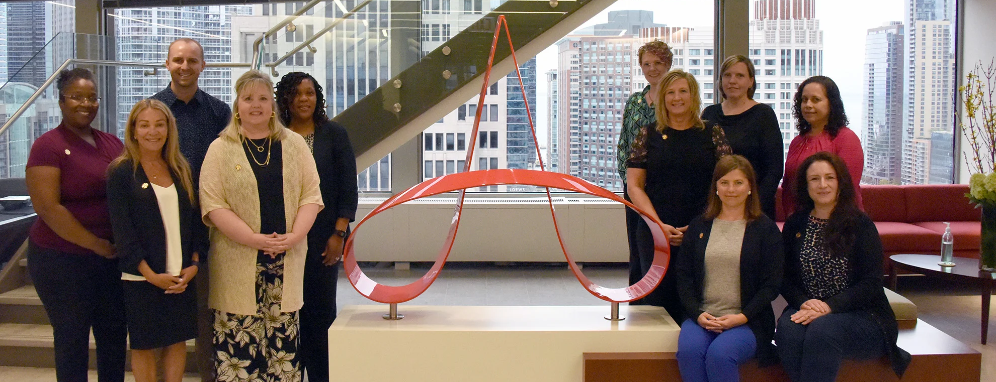
Thank You!

